Slide 1
Tungsten Phase 2 Pilot
Jan 26, 2026

Slide 2
Status update
Goal
Minimize manual work in Account Recordkeeping by automating the classification & processing of incoming transactions using the new Document Scanning Platform – Tungsten Total Agility (TTA)
​
Objective
Classifying & converting extracted data into the format needed for the current SRIPCOMMs and Workflow automation.
​
Scope
90% of Account Recordkeeping Transactions are in Scope for this phase, broken into 6 Processing Tranches & 1 Classification Tranche.
First 5 tranches focus will be on simple & medium complexity transactions to maximize speed to production & benefits realization
Tranche 6 focuses on complex transactions, primarily Transfers
Tranche 1 = 9% of Volume
Tranche 2 = 18% of Volume
Tranche 3 = 10% of Volume
Tranche 4 = 7% of Volume
Tranche 5 = 4% of Volume
Tranche 6 = 40% of Volume (Transfers)
Classification Tranche = 90% of Classification Volume
Targeted Benefits
Overall Goal to achieve a 50-75% reduction in manual effort for the AR team:
Cost Benefit = $2.3m - $3.4m in the US
Benefits will be delivered incrementally beginning in May 2026
Deliver 50% of Benefit by August 2026 = $1.1m - $1.7m
Delivery 100% of Benefit by October 2026 = $2.3m - $3.4m
Today’s Agenda
​
Re-cap of last meeting (Goals, Objectives, Scope, & Targeted Results)
Walkthrough of Plan & Timeline
ASK: How do we accelerate?
Benefits Realization Targets
Critical Dependencies (included in Slides 3&4 with dependency due dates)
Tungsten Platform 2025.02 Availability
Tungsten Engineer
CPU Solutions Architect
Team Updates & Resource Needs (Slide 5)
Reporting / Burndown Charts

Slide 3
Timeline
 |  |  |  |  | Completed
 |  |  |  |  | In Progress
 |  |  |  |  | Not Started
= Deploy
Tranche | Transaction Name | Tranche % | Running total | Feb |  |  |  | Mar |  |  |  |  | Apr |  |  |  | May |  |  |  | Jun |  |  |  |  | Jul |  |  |  | Aug |  |  |  |  | Sep |  |  |  | Oct
 |  |  |  | 2-Feb | 9-Feb | 16-Feb | 23-Feb | 2-Mar | 9-Mar | 16-Mar | 23-Mar | 30-Mar | 6-Apr | 13-Apr | 20-Apr | 27-Apr | 4-May | 11-May | 18-May | 25-May | 1-Jun | 8-Jun | 15-Jun | 22-Jun | 29-Jun | 6-Jul | 13-Jul | 20-Jul | 27-Jul | 3-Aug | 10-Aug | 17-Aug | 24-Aug | 31-Aug | 7-Sep | 14-Sep | 21-Sep | 28-Sep | 5-Oct | 12-Oct | 19-Oct | 26-Oct
1 | Drip OCP Sell Stock | 9.34% | 9.34% | A | A | B | B | B | C | C | C | C | D | D | D | E | E | E
2 | CertReplacement NameAddressUpdate TransferLimited DueDiligence MANDATE | 18.46% | 27.80% |  |  | A | B | B |  |  | C | C | C | C | D | D | D | E | E | E
3 | CorpActionMandatory CustodialTransfer CorpActionOddlotSell Application ReturnedPayments | 10.25% | 38.05% |  |  |  |  |  | A | B | B |  |  |  | C | C | C | C | D | D | E | E | E
4 | W9Update DripTerminateIssue W8 CorpActionPostMerger ADDRESS | 6.74% | 44.79% |  |  |  |  |  |  |  | A | B | B |  |  |  |  |  | C | C | C | C | D | D | E | E | E
5 | ReturnedMail CorpActionVoluntary CorpActionStopLostCert TransferForeignComplex EsppTransfer TaxUpdate | 3.74% | 48.53% |  |  |  |  |  |  |  |  |  |  | A | B | B |  |  |  |  |  |  | C | C | C | C | D | D | E | E
6 | Transfer TransferSell EsppPurchase TransferComplex DTC_DEPOSIT | 40.84% | 89.37% |  |  |  |  |  |  |  |  |  |  |  |  |  | A | A | B | B | B | B | B | B | C | C | C | C | C | C | C | D | D | D | D | D | E | E | E
12 Weeks -> 10 Weeks
12 Weeks -> 9 Weeks
12 Weeks -> 9 Weeks
12 Weeks -> 9 Weeks
As we progress through March, looking to bring this to the left
A | Prep: Design flow and generate PDD and SDD using AI
B | Creae/Test extraction prompt in TTA
C | Build and test RPA flows, incl. API connectivity to back-end systems
D | UAT
E | Deploy & Hypercare

Slide 4
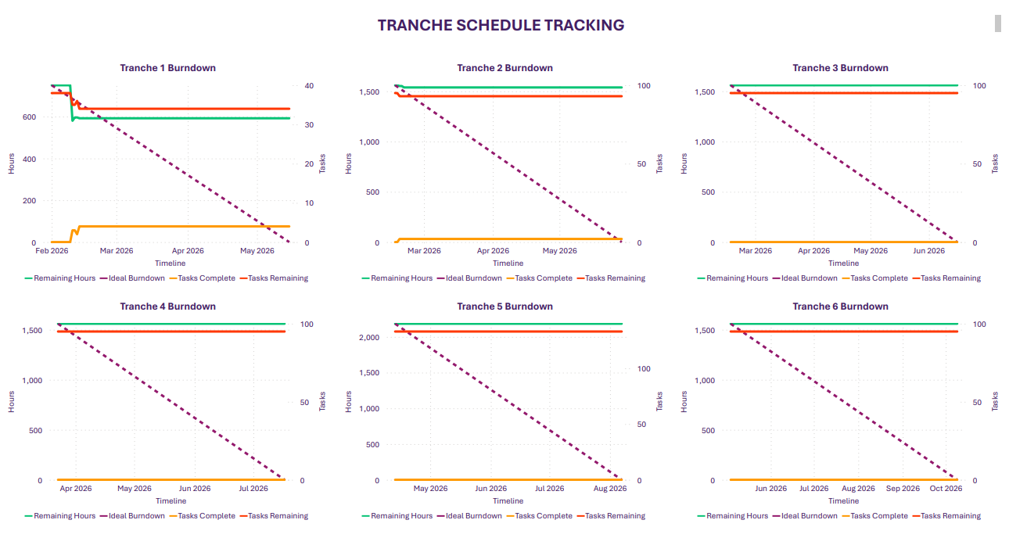
Tranche Burndown Charts
Burndown charts have been created for each tranche and will be able to be reported in real-time

Slide 5
Benefit Equivalency Timeline
Tranches will begin being deployed in April 2026 through September 2026. The below shows the benefit equivalency of the delivered solutions over time. Benefit realization will occur after a hyper care period and confidence the workload has been removed. Timings of savings may be dependent based on scale of FTE reductions and HR processes required for redundancies

Slide 6
There are 3 main considerations to AI tool strategy and approach
Depending on initial test results, the preferred option will be based on a trade-off between LLM accuracy, speed and cost
Option 1A
Option 1B
Option 2
Approach
Multiple specialized agents
Multiple specialized agents + Orchestrator agent
Orchestrator agent refers to DOPs using RAG
Description
Documents classified by human operators, then routed to the specialized AI agent to extract data and sent to workflow for the RPA bot to complete the transaction.
Intent and categorization handled by the first agent, and then classification and data extraction handled by a second agent (possibly using RAG).
One agent that identifies document intent, and refers to a knowledge base of DOPs to classify and extract data
Schematic flow
Scanned mail
Scanned mail
Scanned mail
Manual categorization into 70+ types of transactions
Orchestrator agent
RAG
RAG agent
Data
Transaction agents
Transaction agents
RPA
RPA
RPA
Complexity
One batch of LLM call is made per transaction type by specialized agents
Same methodology, but Orchestrator agent will always make an LLM call to decide which Transaction agent to trigger
One agent that identifies document intent, and refers to a knowledge base of DOPs to classify and extract data
No RAG
No RAG
RAG
+ Scalability: Accessible way to create specialized agents per transaction type based on DOPs
- Maintenance: Prompts need to be maintained individually, QA will be manual in case of errors
- Observability: No grounding mechanism as it does not refer to external documentation to cite as source
Extension of Option 1, with additional Orchestration layer
+ Scalability: Does not require 70+ individual prompts, matches transaction type to DOP rules.
+ Maintenance: Can update a single prompt, DOPs need to be updated with explicit descriptions
+ Observability: LLM grounds answers by citing DOPs, allows us to trace decisions to exact knowledge source
Pro’s/Cons
Current timeline based on Option 1A

Slide 7
Reference & Old Slides
10 mins

Slide 8

Recap: Current incoming mail flow
290 FTE
180 FTE (Account Recordkeeping)
110 FTE (Correspondence)
4.1M (73%) pages are sent to manual teams for processing. This is made up of…
3.9M unknown pages (e.g., handwritten unstructured pages)
0.2M recognised forms (e.g., WF_254UTR, WF_2000DRT)
In Workflow, these results in…
~1M transactions (originated from mails) that teams manually process
0.6M transactions in Workflow originated from unknown mail (‘Workflow’)
0.3M transactions from rerouted transactions (‘HV’)
US Volumes, 2024
Manual
Workflow
Documents manually processed from work items in Workflow
2.7M mails received in mailroom per year (US, 2024)
5.6M pages are scanned (US)
22M pages (Global)
Unknown volumes semi- and un-structured (i.e., ‘Workflow’ and ‘HV’)
39 FTE
Data Services
~0.5M transactions rerouted to workflow (HV) (e.g., Address changes, COA, DRSReject)
EDC
READSOFT
~20% automation error rate
Incoming mail received in mailroom
Mail is opened, and pages physically sorted and assigned batch numbers
Pages are scanned through scanners
Pages are read through OCR software
Pages are
stored and sorted according to business logic by EDC into recognized and unknown forms (or transaction types)
Known form volumes or transactions, structured
(i.e., ‘HV’)
EDC
SCRIP
1.5M transactions sent to SCRIP for automated updates.
There are 337 unique form types in the US that are eligible for automated updates (e.g., RPO1UDC, HV_23UW9, PX_LMH24a)
Automated
EDC does secondary reroutes of out certain known forms for manual teams (e.g., Address changes, COA)
SCRIP is updated automatically
Notes:
Change circles

Slide 9
Today we manually classify & process incoming mailroom transactions
Today’s mailroom journey
High volume (known)
Scanner
Mail
Paper
Sorting table > sorted onshore vs offshore based on PO Box
“Offline classification” is conducted here
Offshore/Onshore > priority > specific transaction type
Medallion checks, Check amount ok, verification, stamping and hole-punching certificates
Stamp if copy or certified
Ticket or separator sheet filled out to include all the details that will be entered in Workflow.
Separating paper envelopes that can’t be shredded
Offshore physical table
(classified envelope ready to be scanned)
Batch allocation
Envelope details entered on Workflow
Workflow
Ready for processing (Sean’s world)
White mail
(unknown)
Image scans of envelope
are scanned and verified by human to ensure papers are complete
EDC checks
Onshore physical table
(classified envelope ready to be scanned)
To be automated (Classification)
To be automated
(Processing)
Goal state: AI-enhanced mailroom journey
NO classification, only physical checks conducted
- Medallion checks, Check amount ok, verification, stamping and hole-punching certificates
Stamp if copy or certified
envelopes that can’t be shredded
Mail
Paper
Data verification checks
(EDC or other)
Image scans of envelope
are scanned and verified by human to ensure papers are complete
Tungsten OCR + AI
Envelope intent extracted, classified, relevant data extracted
Workflow
Ready for processing
Processing automated via RPA, Scripcomms

Slide 10



Phase 1 with Tungsten is almost complete; we are working on automating Phase 2 and 3
Phase 1 – known forms
Phase 2 - Classification
LLM
Phase 3 - Processing
API calls
Extracts fields for all Proxy variations
Known Form Codes
‘High Volume’
Mail
Yes
SCRIP
Matching logic template
Image (TIF) + Text (JSON)
Proxy?
No
EDC
Documents manually processed from work items in Workflow
Paper
E.g., W8, Direct Credit
Fall-outs
Workflow
Scanner
Classification
Processing (RPA automation)
Manual review
Image (TIF)
Yes
Doc IMG + extracted data
OCR (+MSDI)
Unknown
LLM
</>
No
RPA automations in BluePrism complete transaction processing, using APIs to SCRIP
Barcode recognized?
Logic to verify data matches with our database
Audit log
Workflow
Image (TIF)
+
Text (JSON)
Transforms unstructured data into a structured output
Match?
Transcation approved manually for Processing
E.g., Share Certificate, Death Cert.
Extracts intent and fields
No
Yes
XML
Workflow
EDC
COSMOS Company
Open question - What load can it handle? We expect to send many requests per day
SCRIP
COSMOS Investor
Elastic in lieu of Cosmos
(dev only, not prod) but easy to set up

Slide 11
Overview of Document Processing workplan
Today
Critical dependencies
 | FY 26 |  |  |  |  |  |  |  |  | FY 27
 | Q2 OCT-DEC |  |  | Q3 JAN-MAR |  |  | Q4 APR-JUN |  |  | Q1 JUL-SEP |  |  | Q2 OCT-DEC |  |  | Q3 JAN-MAR
 | OCT | NOV | DEC | JAN | FEB | MAR | APR | MAY | JUN | JUL | AUG | SEP | OCT | NOV | DEC | JAN | FEB | MAR
Upgrade to Tungsten
Production
(US)
Access to TTA 25.2 before Feb 9 (on track)
Production
(Global)
Processing
Prep
phase
$
$
Tranche 1
DRIP OCP and Sell Stock)
12 weeks
$
Tranche 2
Tranche 3
$
Processing team Immediate focus
Tranche 4
Details next
$
TTA Resource required by mid-Feb
(on track)
Tranche 5
US Account R’keeping
(est. 2-4M impact)
Classification
Learnings from Tranche 1 as input
Preliminary timings
Design
Permissions & Design
Pilot
(auto-classification)
Build and prepare for production
CPU Infrastructure Solutions Architect required
US Mailroom
(est. ~10-15 FTE impact)

Slide 12
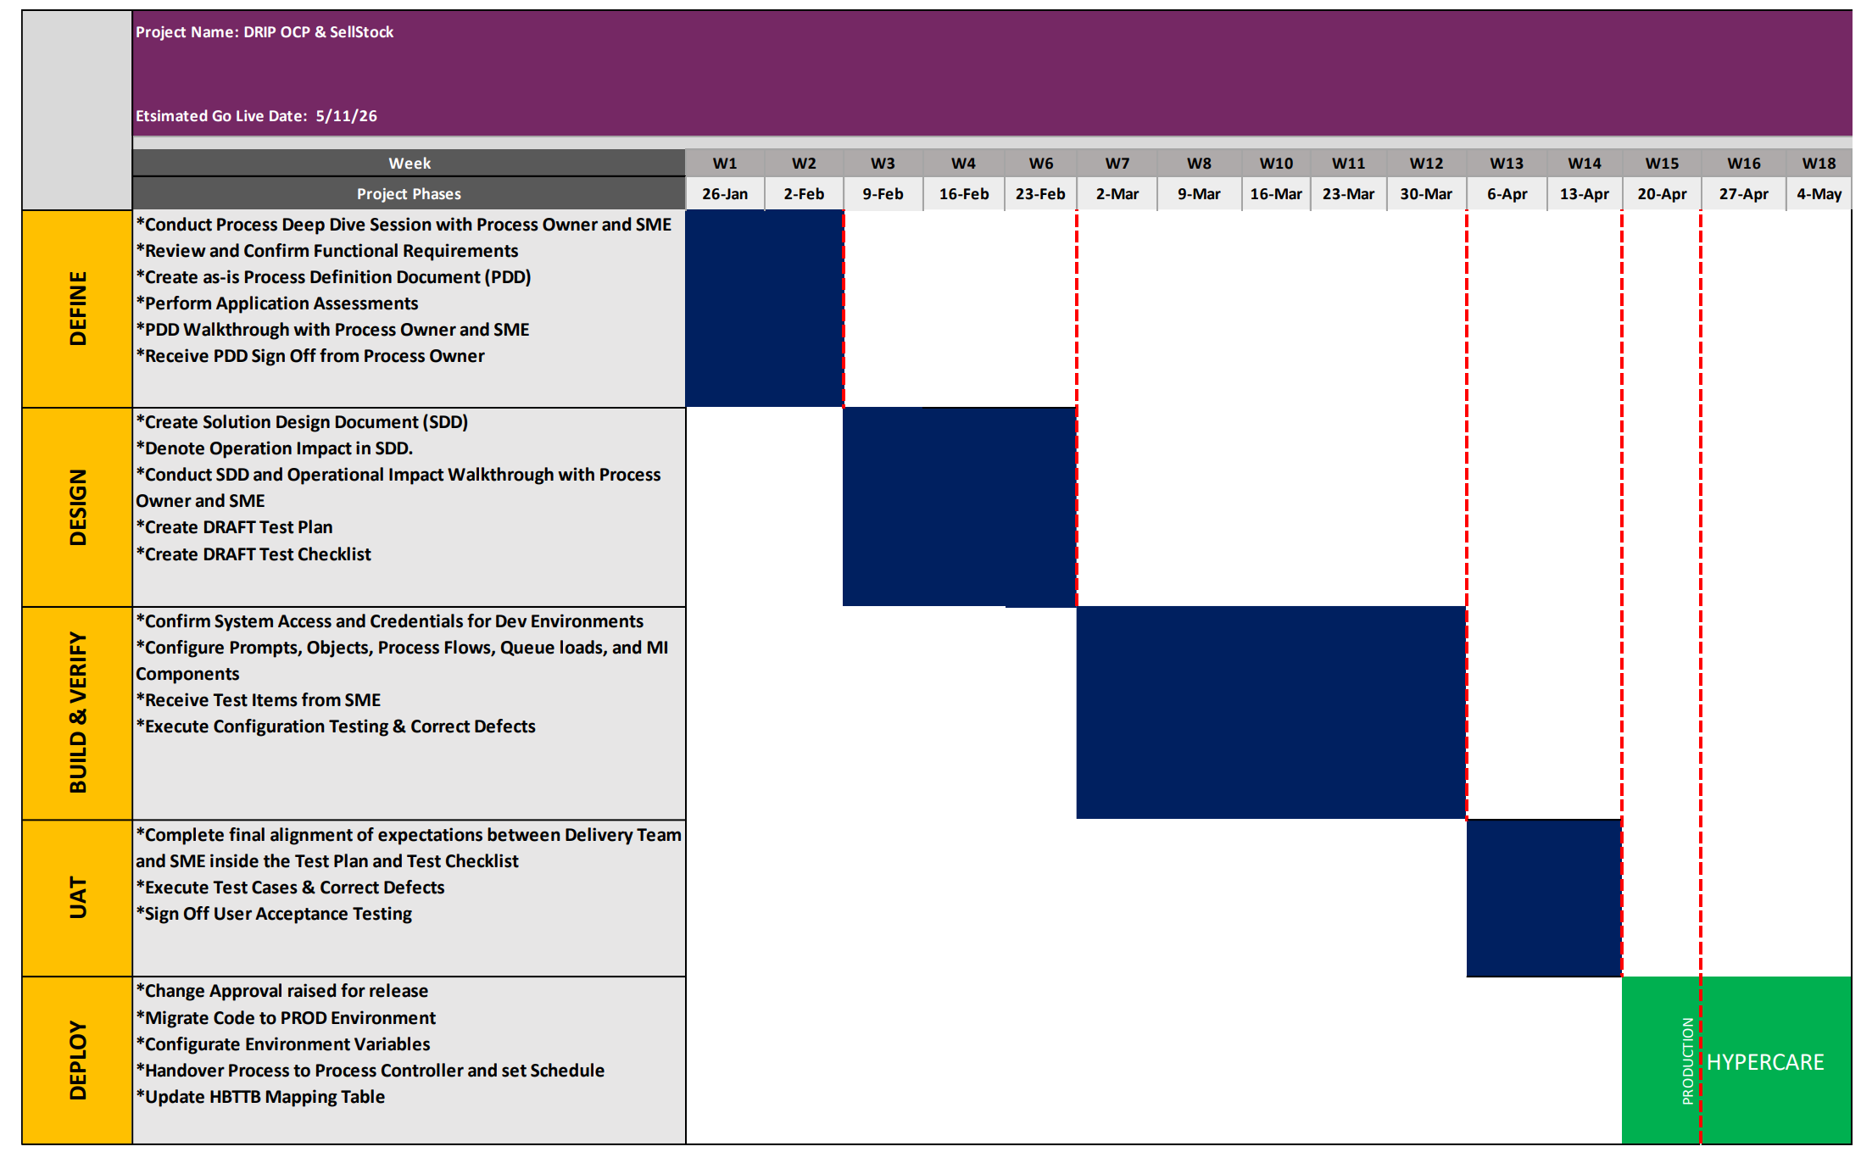
Weekly workplan for Tranche 1 (DRIP OCP & SellStock)
This is a repeatable workplan module applicable to all transaction tranches
Define Phase Exit Dependencies:
Tungsten resource
Infrastructure Solutions Architect
TTA Platform access
SCRIP comms sign off
UAT Phase Dependency:
SME availability

Slide 13
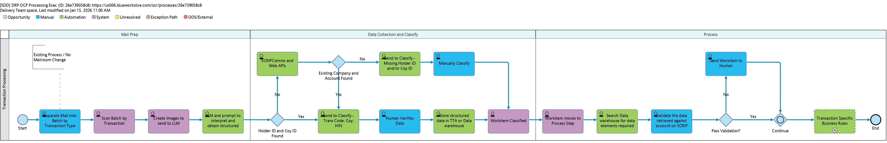
Processing – DRIP OCP flow
Automate processing transactions after human verifies classification
To be replaced with Ben’s updated diagram
Mailroom scanning process does not change
Data extraction in TTA
Human verification (Workflow)
Processing (RPA to SCRIP, Workflow)
75% of savings impact
Classification automation pilot to start after Tranche 1 of Processing
25% of savings impact
STP achieved once Classification and Processing automation is complete

Slide 14
Status update
Today’s Agenda
​
Re-cap of last meeting (Goals, Objectives, Scope, & Targeted Results)
Walkthrough of Plan & Timeline for Prep Phase & Tranche 1 (Slides 3 & 4)
Critical Dependencies (included in Slides 3&4 with dependency due dates)
Tungsten Platform 2025.02 Availability
Tungsten Engineer
CPU Solutions Architect
Team Updates & Resource Needs (Slide 5)
DripOCP Process Flow
Re-Cap of Last Meeting
​
Goal
Minimize manual work in Account Recordkeeping by automating the processing of incoming transactions using the new Document Scanning Platform – Tungsten Total Agility (TTA)
​
Objective
Our focus is on processing initially, as it has the greatest FTE impact, by converting extracted data into the format needed for the current SRIPCOMMs and Workflow automation.
​
Scope
Processing Tranche 1: DripOCP and SellStock
Concentrate on two transaction groups—ranked 2nd and 10th in FTE effort to process.
This phase will establish a scalable framework for prompting and automation, paving the way for subsequent phases.
Processing Trance 2, 3, 4, and others: TBD Transactions
In parallel to Tranche 1, the team is analyzing the remaining transactions and will propose a sequencing of transactions based on volumes and complexity to maximize benefit realization
Targeted Results
Processing: Achieve a 50% reduction in manual effort for the AR team.

Slide 15


AI tool strategy and approach
Depending on initial test results, the preferred option will be based on a trade-off between LLM accuracy, speed and cost
 | Option 1- multiple specialised agents | Option 2- One agent + RAG | Option 3- Orchestrator agent + specialised agent
Description | Documents classified by human operators, then routed to the specialised AI agent to extract data and sent to workflow for the RPA bot to complete the transaction. | One agent that identifies document intent, and refers to a knowledge base of DOPs to classify and extract data | Intent and categorization handled by the first agent, and then classification and data extraction handled by a second agent (possibly using RAG).
Schematic flow
Automation efficiency | Low | High | Medium
Complexity | Simple (prompt only) | Medium (one or more RAG agents needed) | Medium (one or more RAG agents needed)
OKRs | Accuracy, speed, cost | Accuracy, speed, cost | Accuracy, speed, cost
Transaction
agent
Doc scanned
Doc classified, data extracted
</>
Doc scanned
Transaction
agent
Doc scanned
Classifier
agent
RPA
bot
Orchestrator
agent
Doc categorized
</>
Human
operator
data extracted
</>
Query
Answer
Transaction
processed
Query
Answer
Transaction
agent
Data extracted
Doc classified
Transaction
agent
RPA
bot
RPA
bot
Transaction
processed
Transaction completed
Data
Data
Transaction
agent
Transaction
agent

Slide 16
AI tool strategy and approach
Depending on initial test results, the preferred option will be based on a trade-off between LLM accuracy, speed and cost
 | Option 1- multiple specialised agents | Option 2- One agent + RAG | Option 3- Orchestrator agent + specialised agent
Description | Documents classified by human operators, then routed to the specialised AI agent to extract data and sent to workflow for the RPA bot to complete the transaction. | One agent that identifies document intent, and refers to a knowledge base of DOPs to classify and extract data | Intent and categorization handled by the first agent, and then classification and data extraction handled by a second agent (possibly using RAG).
Validation tests needed | Number of specialised agents: Do we need 73 specialised agents or can that number be reduced to cluster transactions? LLM data extraction accuracy: Accuracy of data extraction OCR only vs LLM: If classification is determined manually, then it may be faster to use TTA OCR without any LLMs to extract data deterministically) | LLM Intent identification accuracy LLM data extraction accuracy LLM load tolerance: Is one agent sufficient to handle all cases? Or do we need multiple? | Number of specialised agents: Do we need 73 specialised agents or can that number be reduced to cluster transactions? LLM Intent identification accuracy LLM data extraction accuracy
Automation efficiency | Low | High | Medium
Complexity | Simple (prompt only) | Medium (one or more RAG agents needed) | Medium (one or more RAG agents needed)
OKRs | Accuracy, speed, cost | Accuracy, speed, cost | Accuracy, speed, cost

Slide 17
Simple Transaction Recordkeeping (DRIP OCP)
10 mins

Slide 18
Recordkeeping: DRIP OCP
A2
A1
A2
Overview of effort
Key process steps
 | FTE Effort
Classify | 0.54
Process | 0.60
 | Step | System used | Who
1 | Open mail | Manual | Mailroom
2 | Scan mail | Workflow (via EDC) | Mailroom
3 | Process checks | Workflow | Accnt R’keeping
4 | Update Account Info | SCRIP | Accnt R’keeping
5 | Update OCP Database | OCP Database | Accnt R’keeping
6 | QA, end flow | Workflow | Accnt R’keeping
7 | (Reconciliation) Mailroom run OCP report to see additions to system that day | OCP Database | Mailroom
Drip sponsored by client, DSPP sponsored by CPU
B1
B2
Separate into 1) initial application and 2) investment, if you get form c >> initial app. If no C, then apply funds to purchase
Volumes
Row Labels | Volume (Mail, US) | FTE Effort | Volume (%) | Future categorization (transaction level)
DripOCP | 13,191 | 1.145 | 2% | DRIPOCP
MatReqDripKit | 1584 | 0.270 | 0% | DRIPOCP
DripEnrollment | 1385 | 0.115 | 0% | DRIPOCP
DRIPElection | 694 | 0.024 | 0% | DRIPOCP
DripOCPWeb | 588 | 0.097 | 0% | DRIPOCP
DripTerminateSell | 284 | 0.037 | 0% | DRIPOCP
DripPurchase | 70 | 0.003 | 0% | DRIPOCP
DripTerminateIssue | 11 | 0.000 | 0% | DRIPOCP
EsppDripEnrollment | 6 | 0.002 | 0% | DRIPOCP
C
Typical contents of envelope
 | Page | Type | Field extraction required per page | Future categorization (page level) | Future categorization (envelope level)
A1 | Cheque | Structured, unknown | Amount, Date, Name | Cheque Front | DSPP OCP
A2 | Cheque (back) | Unstructured, unknown | None | Cheque Back
B1 | Handwritten instructions (back) | Unstructured, unknown | Name, Email, Phone Number, Company Name, Address, Account Number | [Sell]/intent instruction letter
B2 | Card | Unstructured, unknown | None | Card
C | Direct Stock Purchase Plan, Initial Enrolment Form (Code: 62UEF) | Structured, known form | Same as Phase 1 | DSPP Initial Enrolment Form

Slide 19
Standard Transaction Sell Stock
15 mins

Slide 20
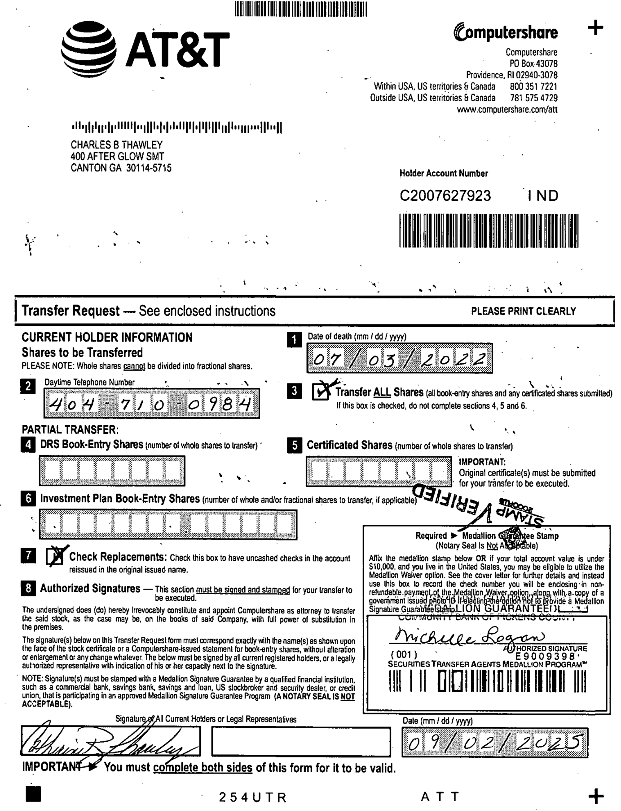
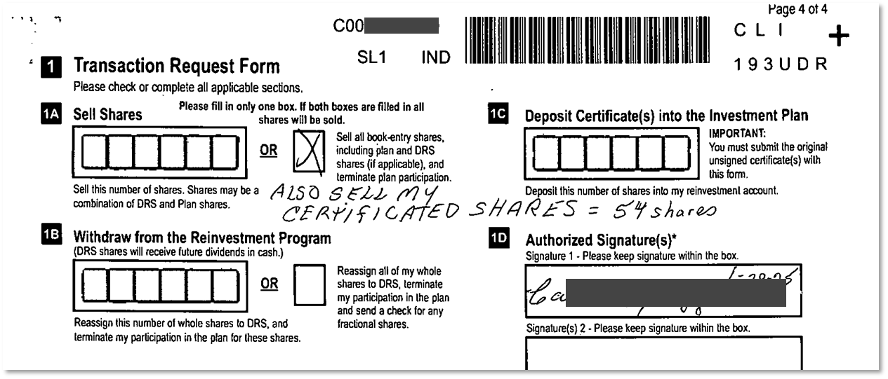
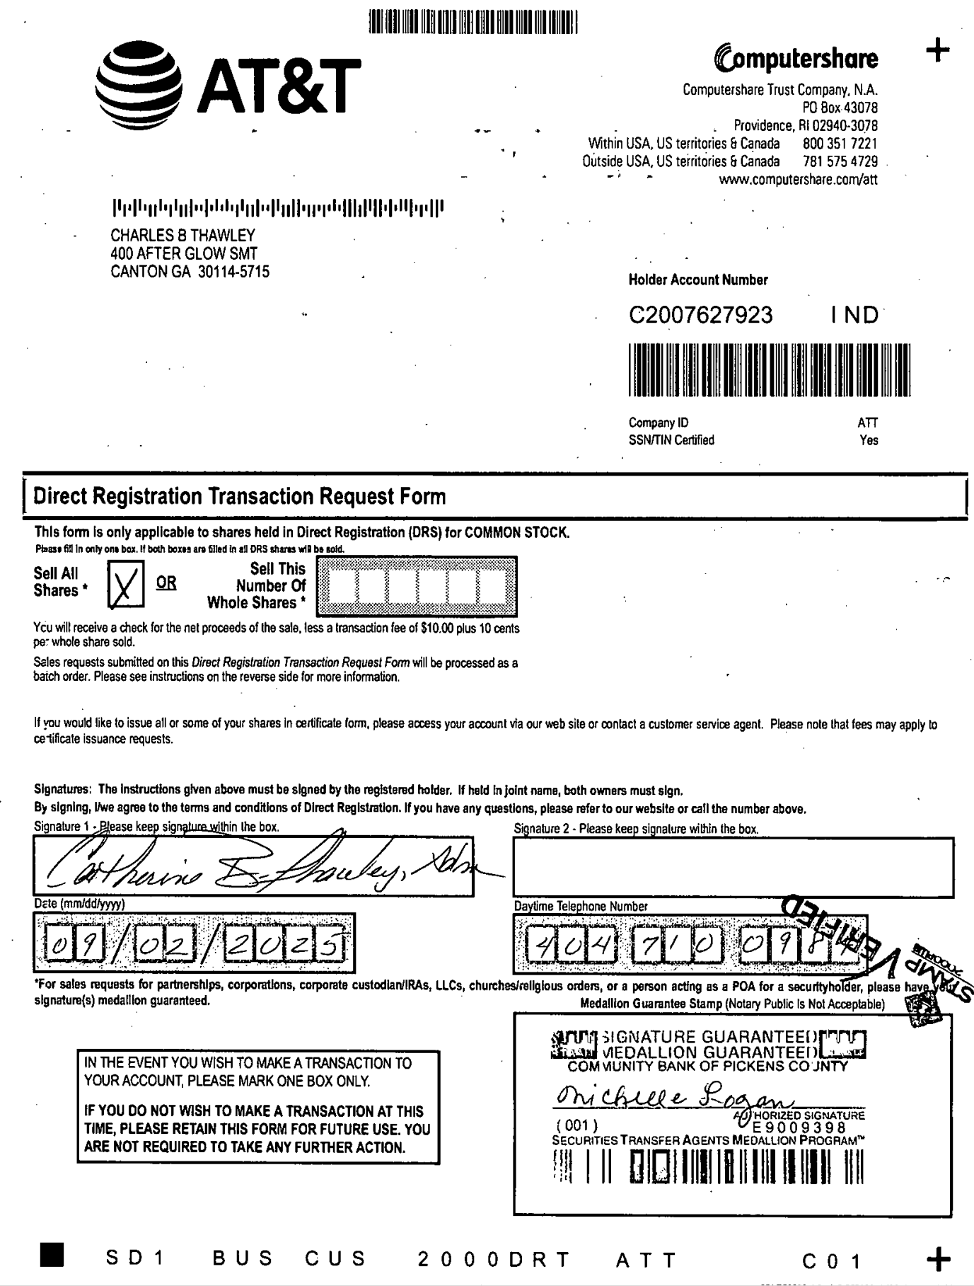
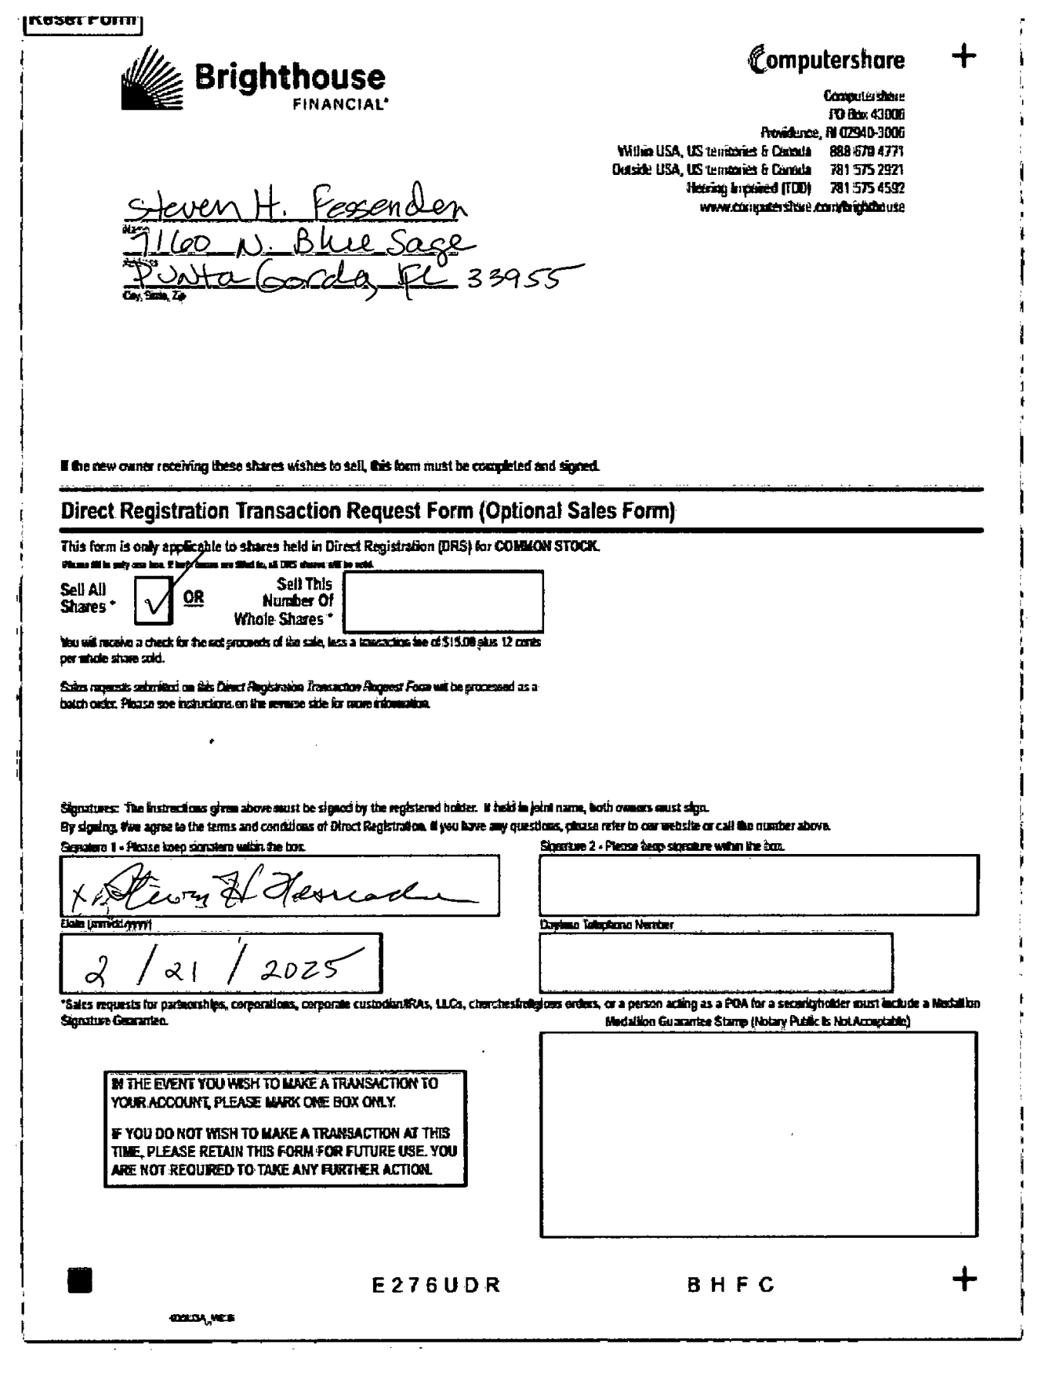
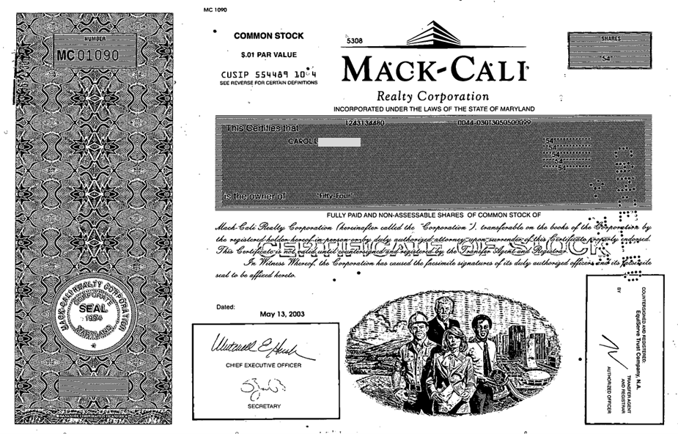
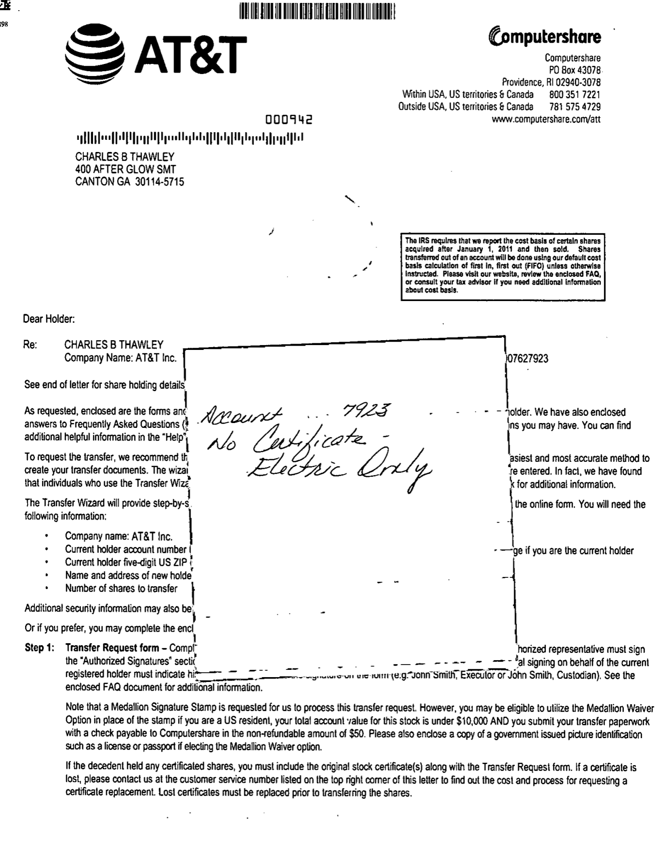
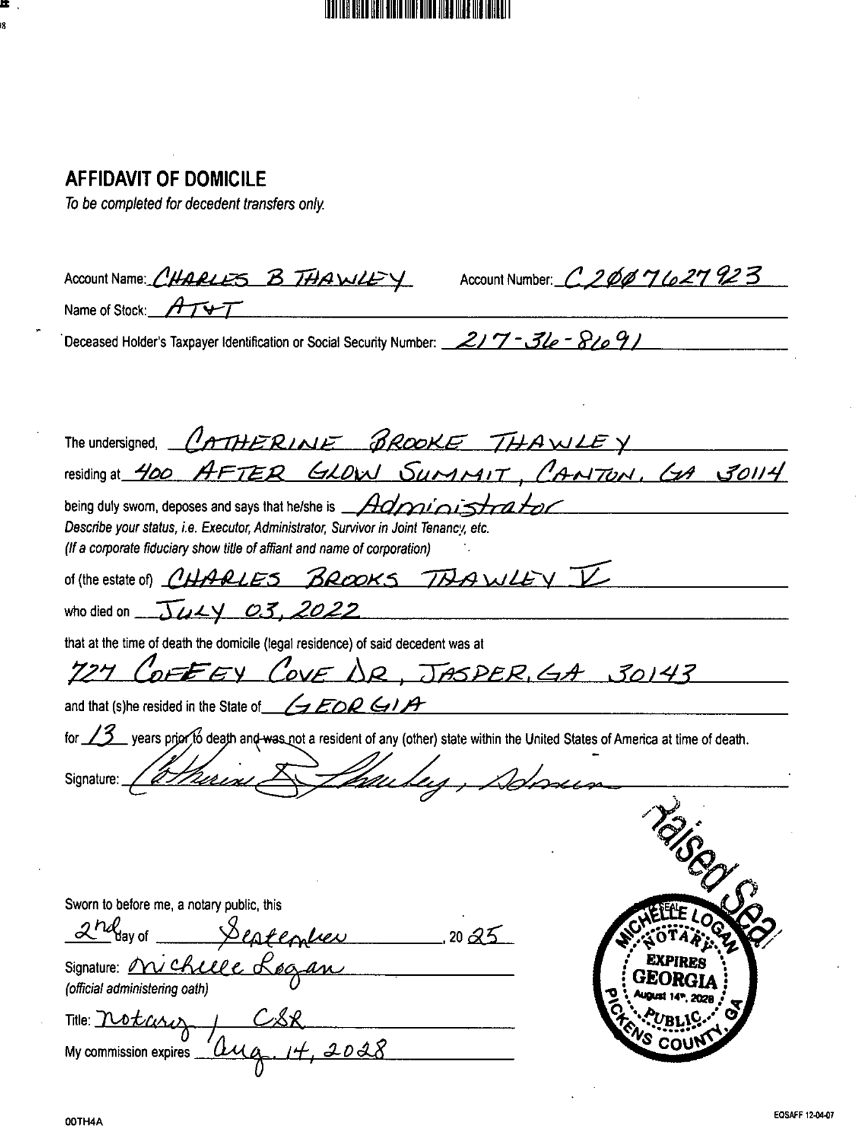
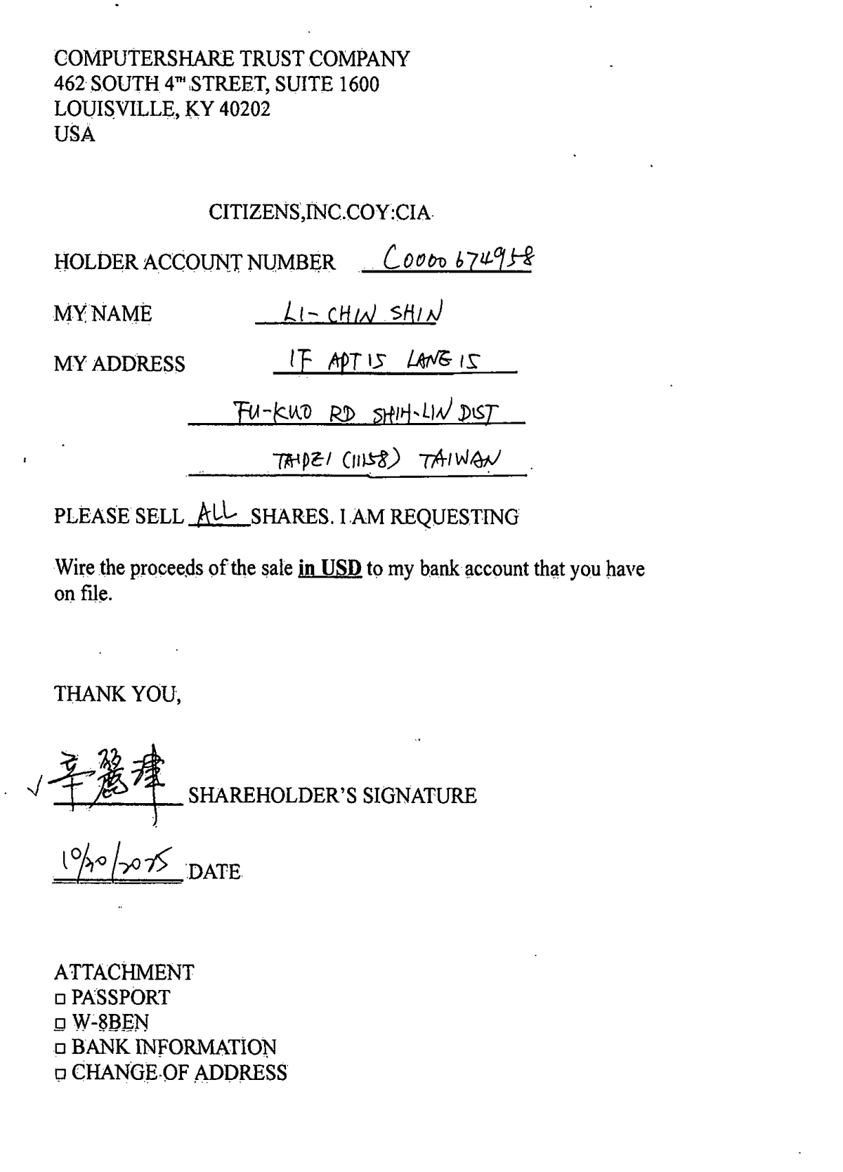
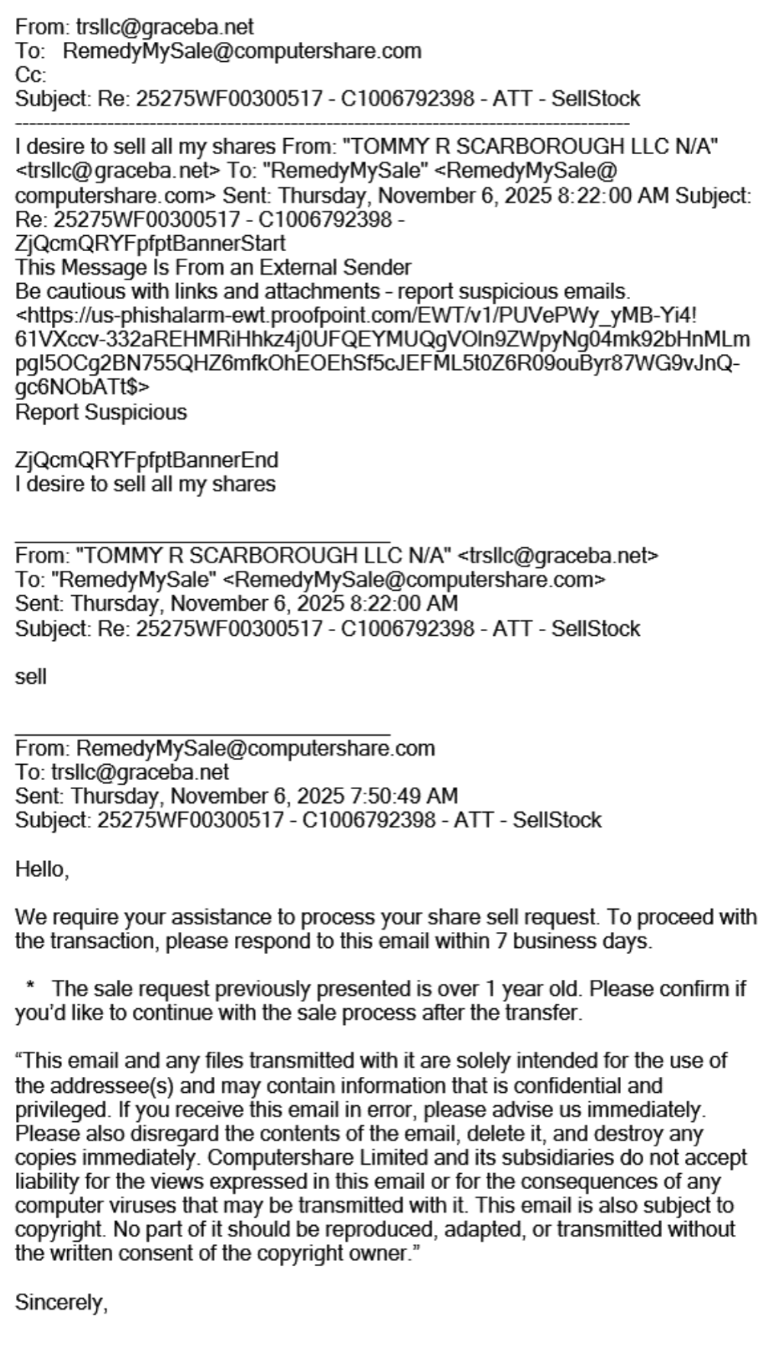
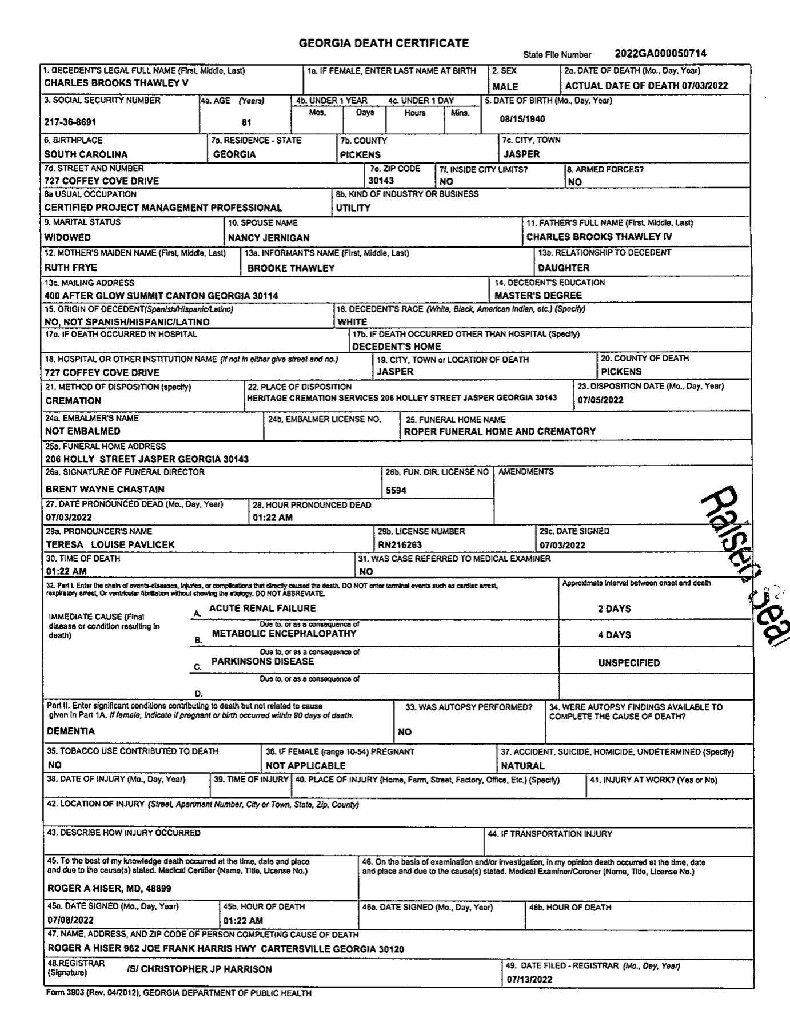
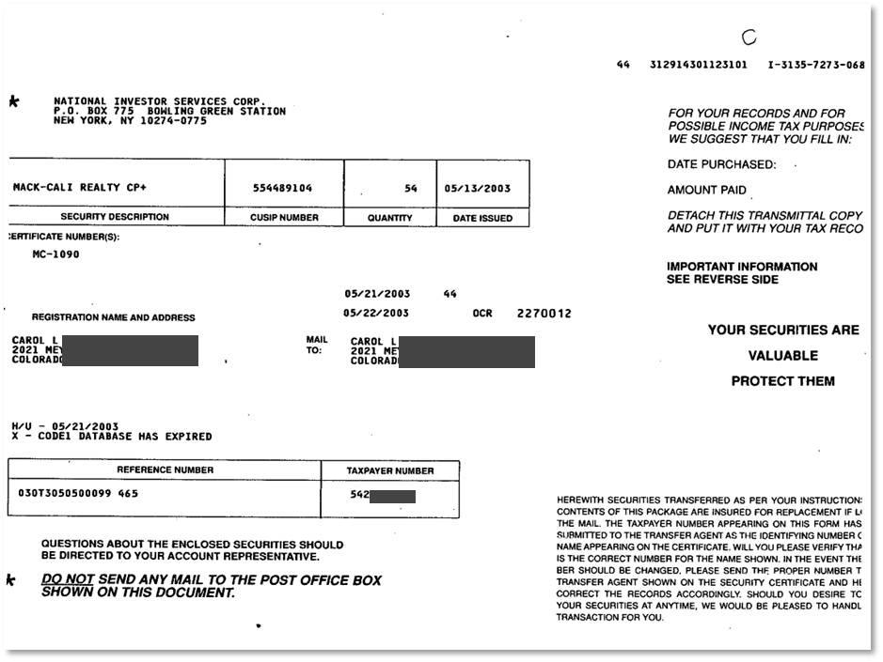
Overview: SellStock
A1
A2
Overview of effort
Key process steps
 | FTE Effort
Classify | 0.38
Process | 2.95
 | Step | System used | Who
1 | Open mail | Manual | Mailroom
2 | Scan mail | Workflow (via EDC) | Mailroom
3 | Process checks | Workflow | Accnt R’keeping
4 | Validate details and update | SCRIP | Acc’t R’keeping
B
Volumes
Row Labels | Volume (Mail, US) | FTE Effort | Volume (%) | Future categorization (transaction level)
SellStock | 30140 | 3.33 | 5% | Sell Stock
Typical contents of envelope
C
 | Page | Type | Field extraction required per page | Future categorization (page level) | Future categorization (envelope level)
A1 | Transaction Request coupon (Code:193UDR) | Structured, known form | HIN, COY, Amount of shares | Sell stock coupon (phase 1) | SellStock
A2 | Transaction request form | Structured, known form | HIN, COY, Amount of shares | Sell stock Form (phase 1)
B | Privacy Notice | Structured, unknown | None | Privacy notice
C | Share Certificate | Structured, unknown | Certificate number, number of shares, CUSIP, SCL number | Certificate
D | Handwritten or typed instruction | Unstructured, unknown | HIN, COY, Amount of shares | Handwritten or typed Sell instruction
E | Supporting documents | Unstructured, semi structured, unknown | Name, Address, HIN, COY, Amount of shares, intent | Affidavit of Domicile, W9 Form, Death certificate
D
E

Slide 21
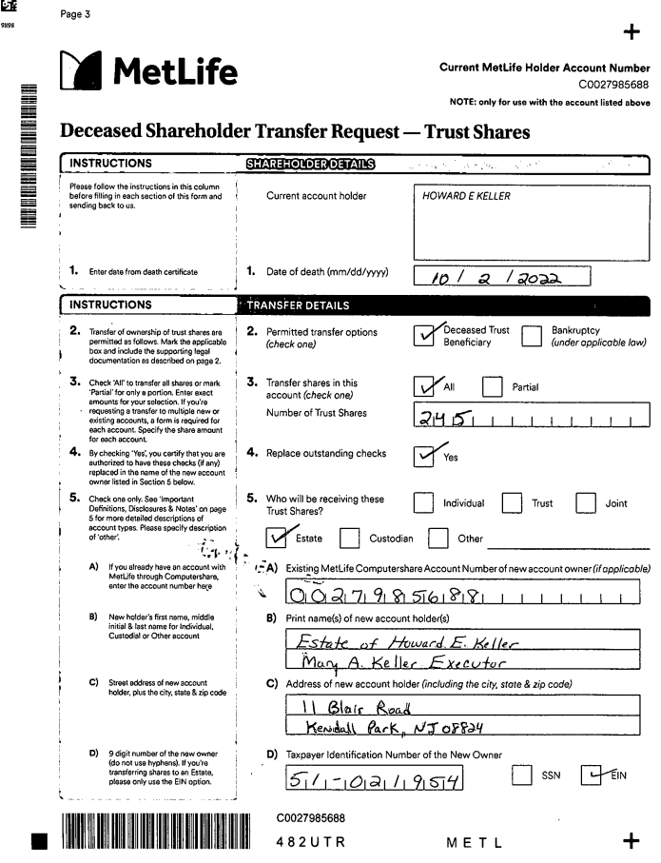
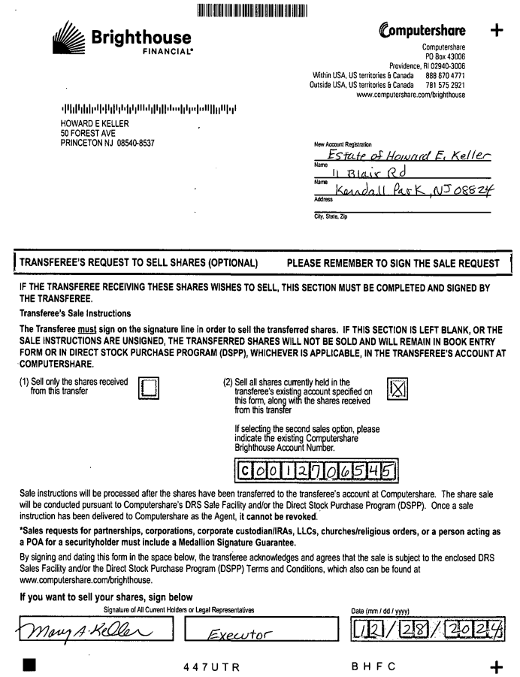
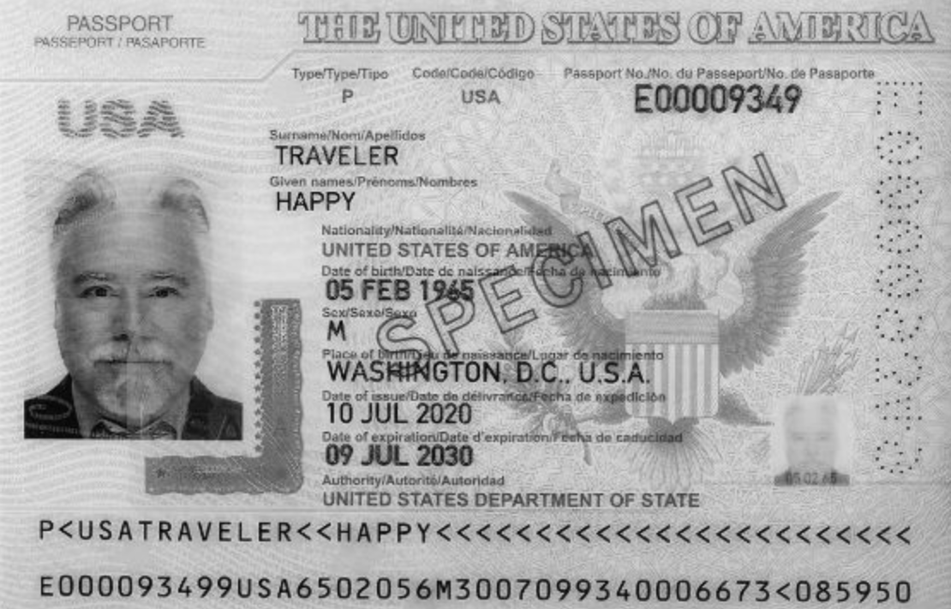
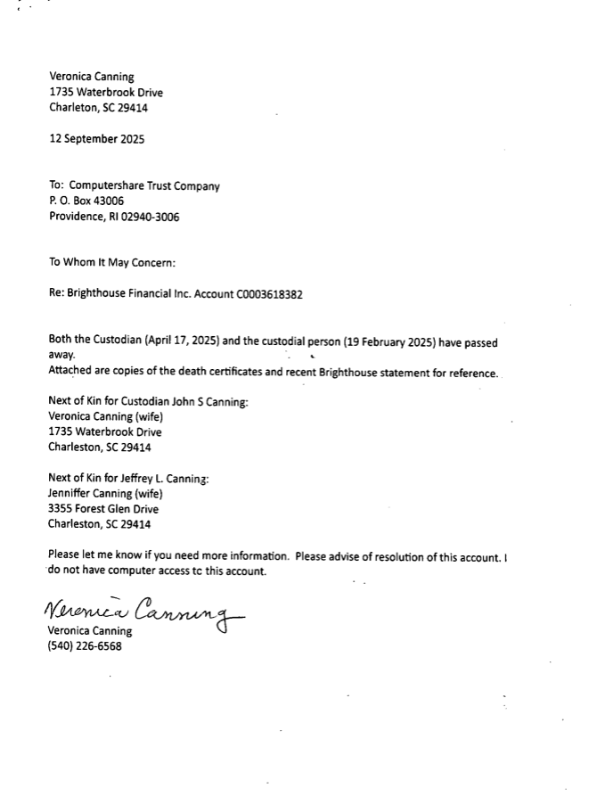
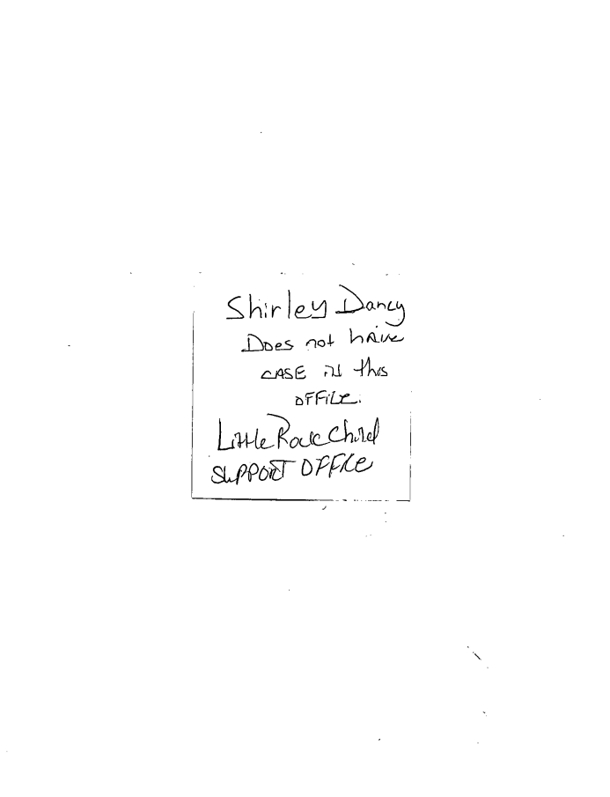
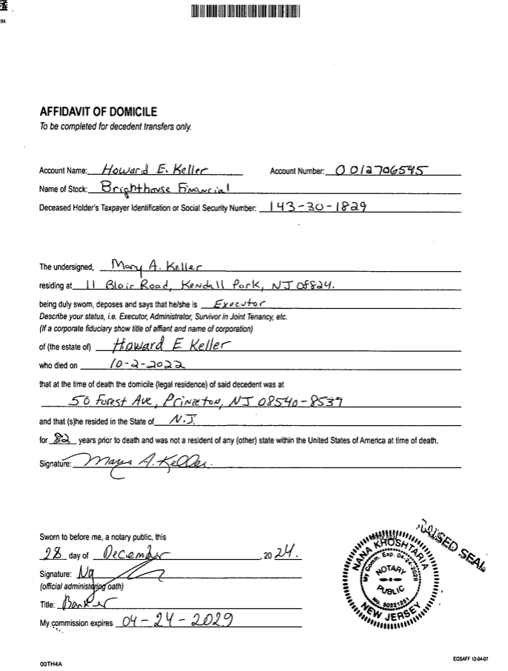
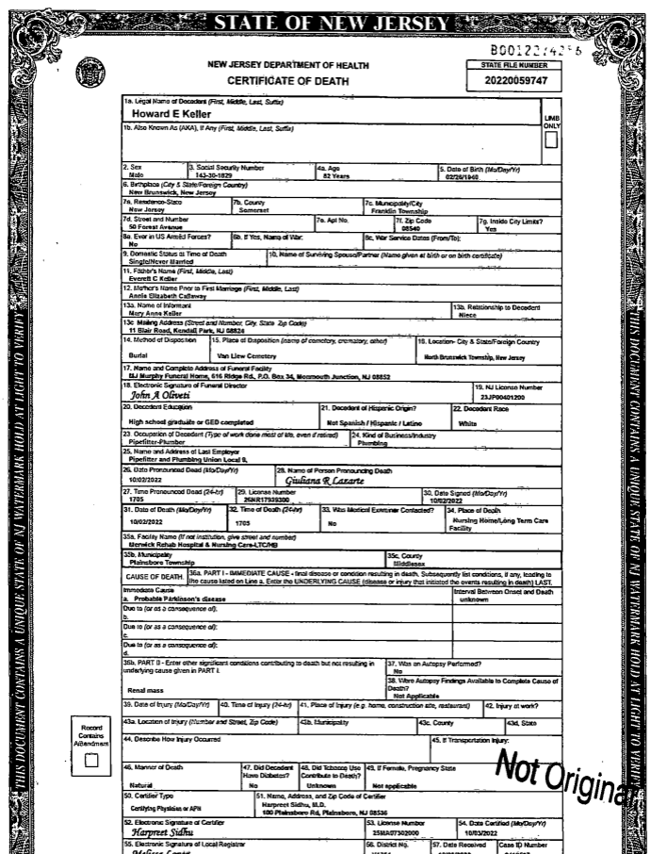
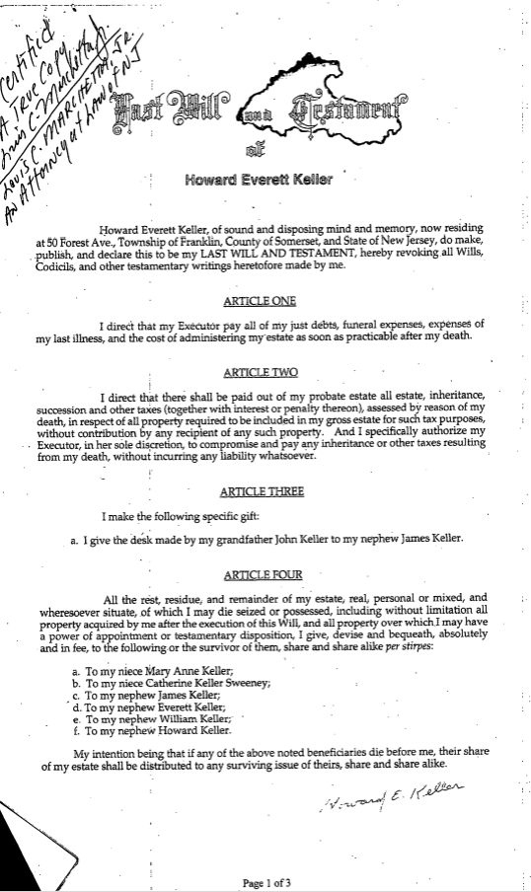
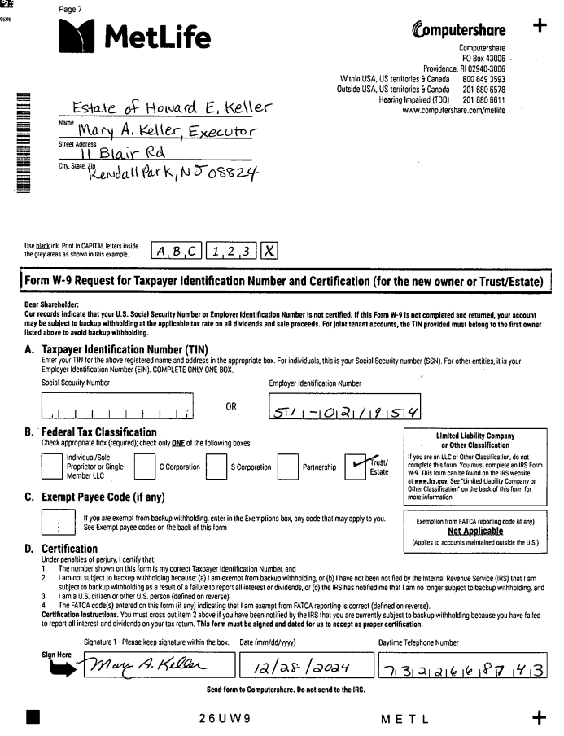
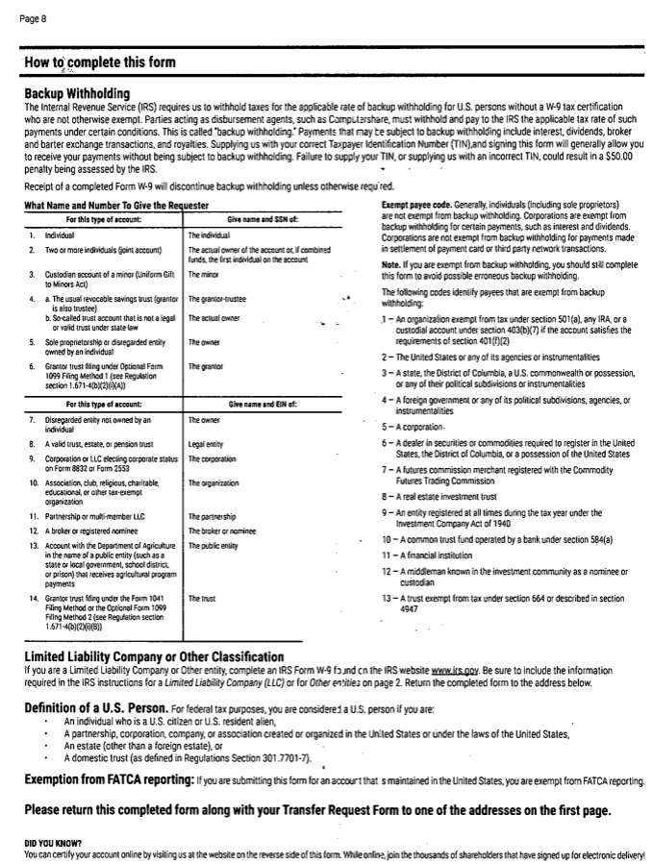
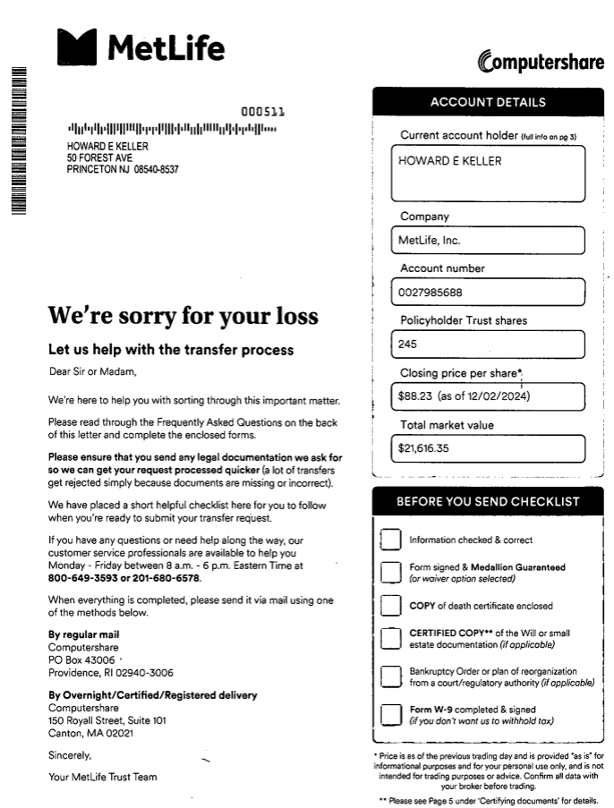
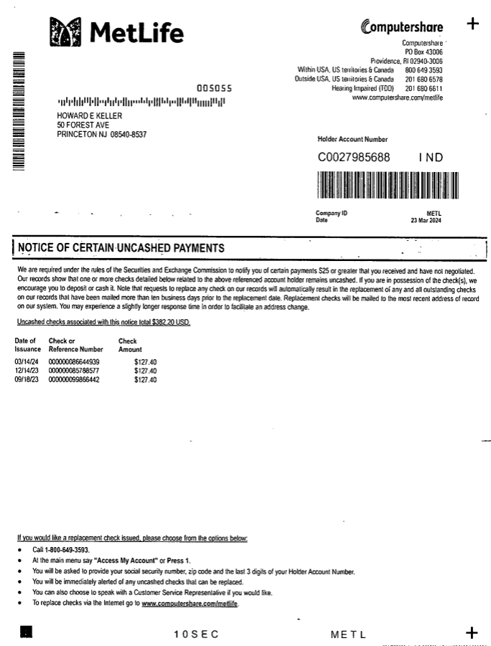
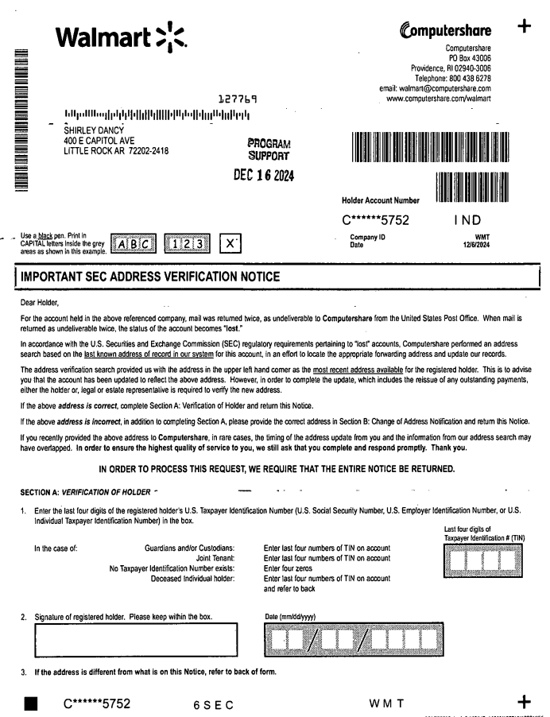
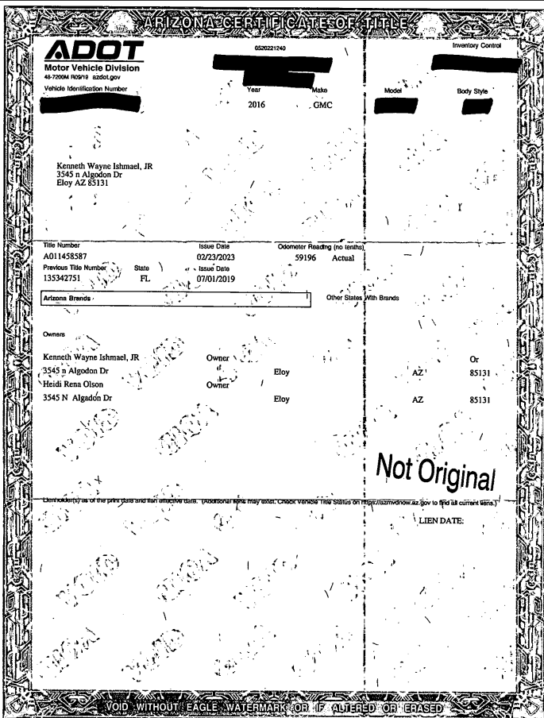
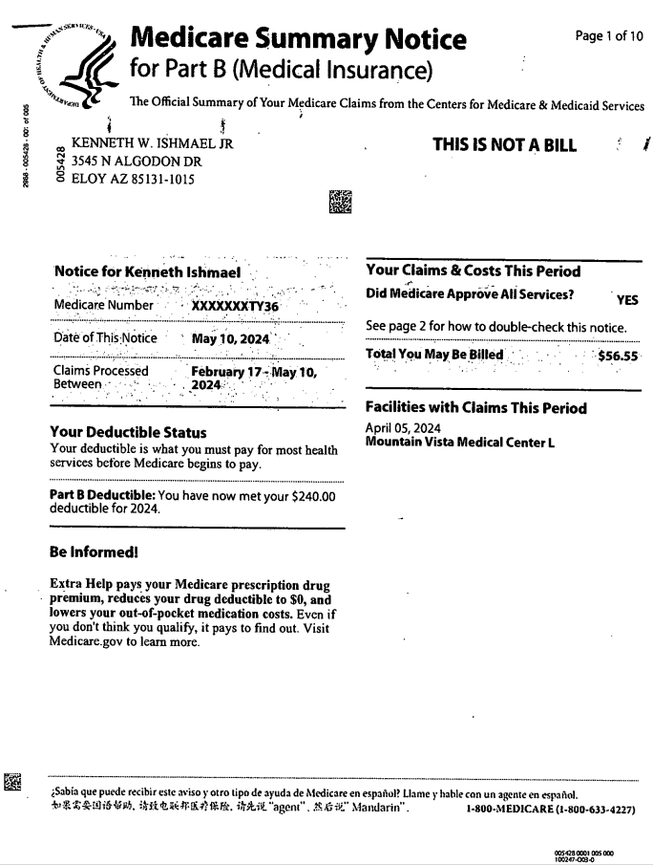
A
B
C
Deceased shareholder transfer
482UTR
Transfer request to sell shares
447UTR
Typed letter
Handwritten note
D
E
Affidavit of Domicile
Death certificate
Will
W9
Instructions
Cover letter
Uncashed investments notice
Change of Address (6SEC)
DMV document
Medical insurance
Medical insurance

Slide 22
What data is necessary to classify?
Query | Data point | Data source (constructed) | What CPU information is used to create this data source?
1. What is the document intent//what does the shareholder want to do? | Categorization bucket (Column A) | Transaction routing table | QRG, Reclassifying and insert scenario document, some information from DOPs
2. For which company? One or multiple? | COY | Company code translation table | Cosmos company
3. Who is the recipient? | Individual | Incoming envelope | Incoming envelope
4. What is the account number? | HIN | Incoming envelope | Incoming envelope
5. Is there an account for the credit? | Yes or no | Incoming envelope | Incoming envelope
6. Run checks to classify | Which company? Is there a doc return form? Section 144 reference? Etc. | Transaction routing table | QRG, Reclassifying and insert scenario document, some information from DOPs
7. Based on results of 6, classify into a specific transaction type | Specific classification type (potentially rationalized) | Transaction routing table | QRG, Reclassifying and insert scenario document, some information from DOPs

Slide 23
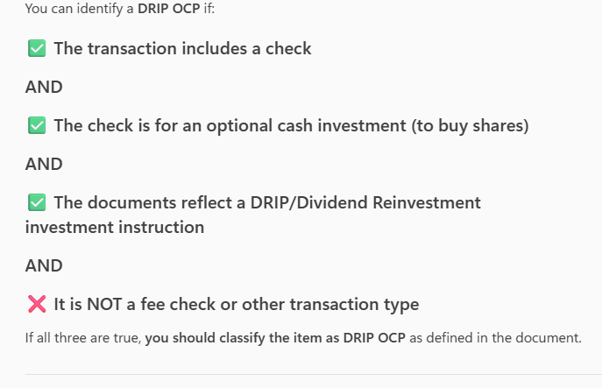
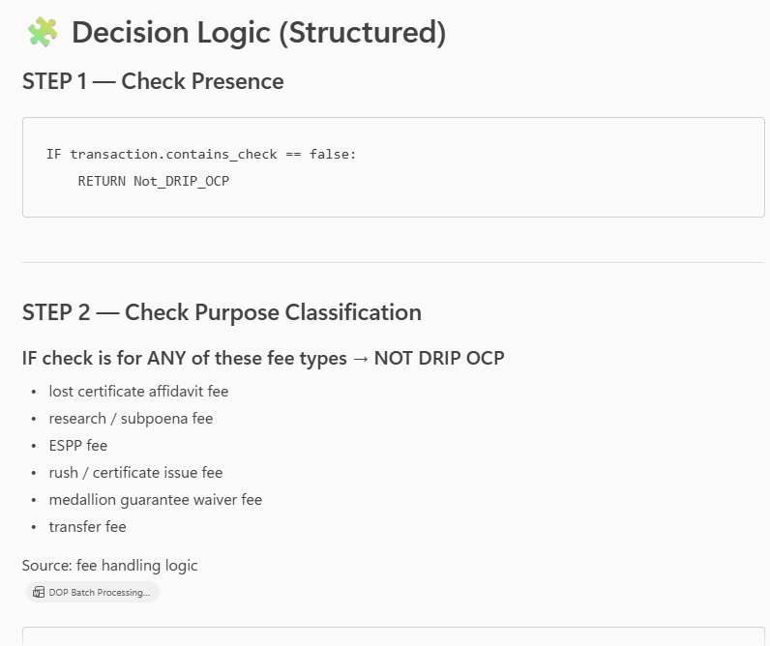
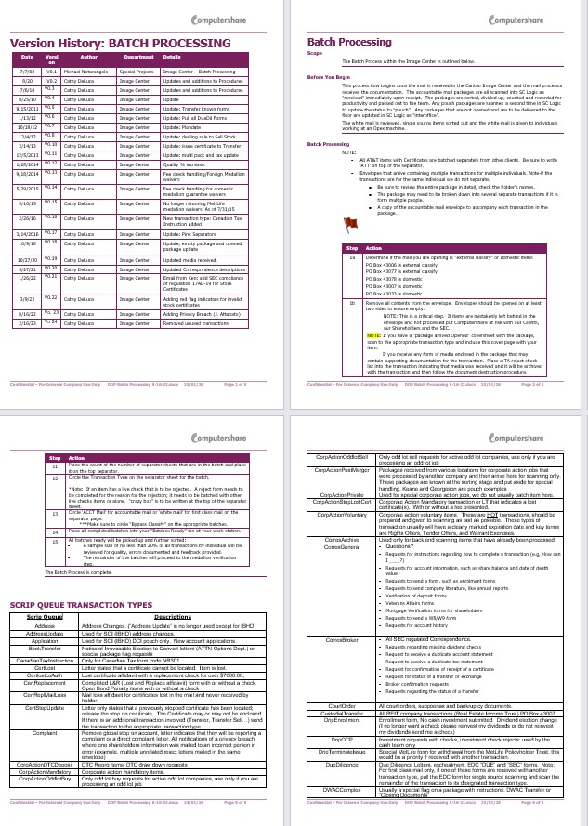
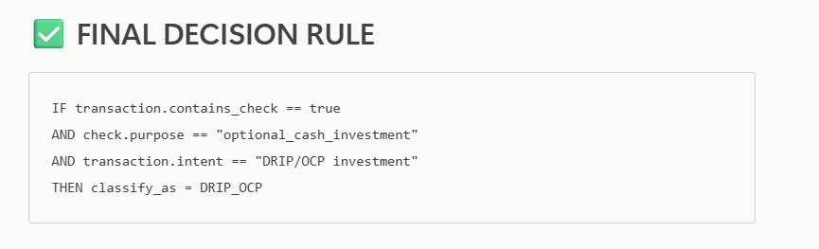
Extracting categorization instructions using Copilot, rewriting it for an LLM to scan
Original DRIP OCP categorization document
Extracting step-by-step instructions from DRIP OCP classification document
Rewriting instructions optimized for an LLM to scan

Slide 24
Step by step flow – how to categorize DRIP OCP
No – not DRIP OCP
Yes – Is the check for any of those categories:
Lost certificate affidavit
Research/subpoena/ESPP fee
Rush/certificate issue fee
Medallion guarantee waiver fee
Transfer fee
No – check for indications like:
“Please invest”
“Optional Cash Purchase”
Dividend reinvestment statement
OCP investment request
A check amount that is not a fixed fee amount (aligns with an investment)
No – not DRIP OCP
Scan the envelope
Does the transaction include a check?
Yes – DRIP OCP but REJECTED
Verify if the check is:
Unsigned
Unacceptable format
Incorrect payee
Missing required info
Yes – DRIP OCP
Yes – DRIP OCP but ACCEPTED (go ahead and extract info)
Yes –not DRIP OCP

Slide 25
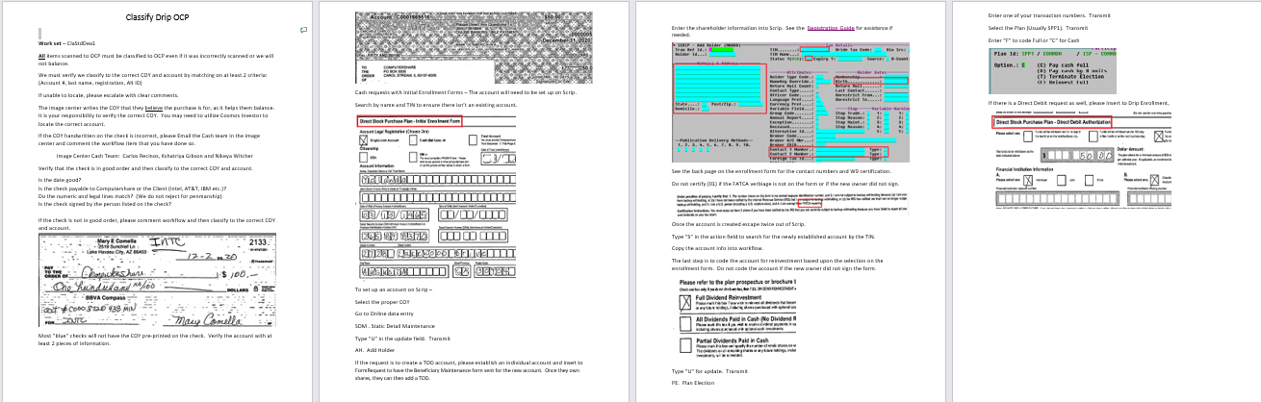
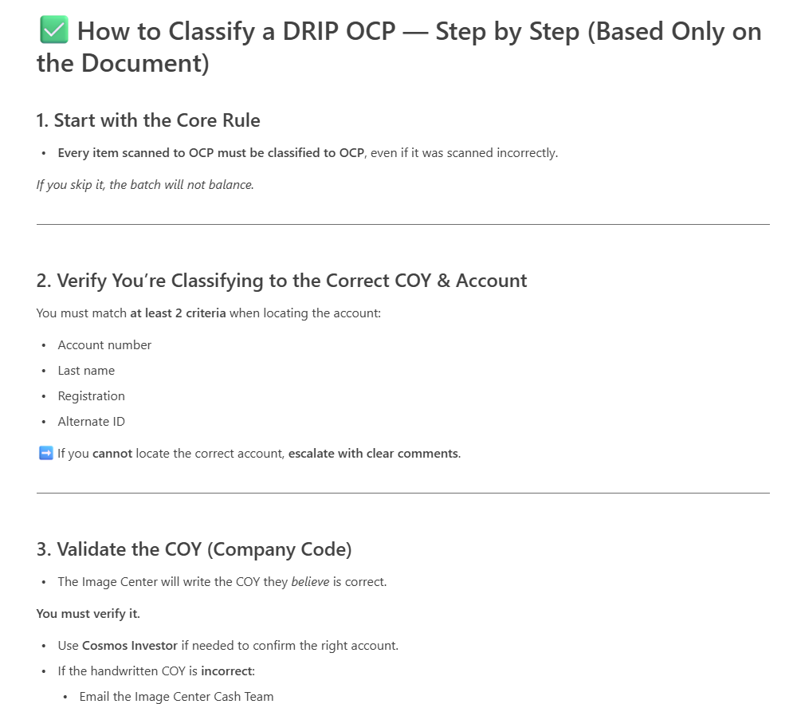
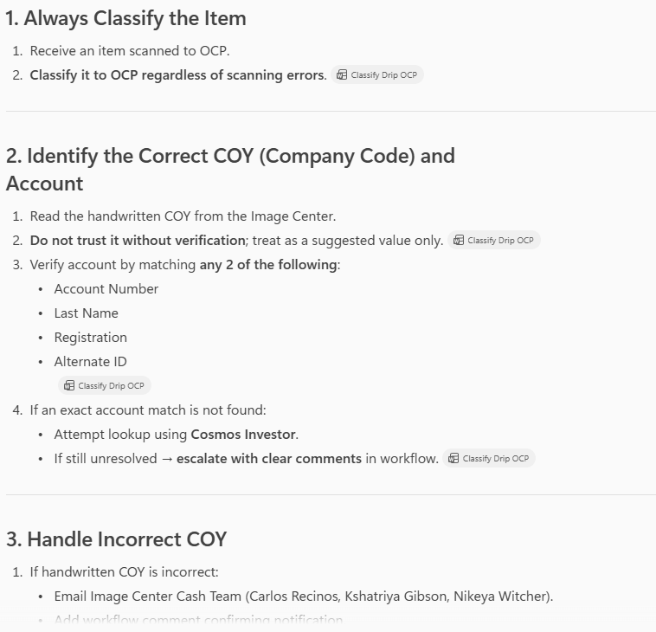
Extracting classification instructions using Copilot, rewriting it for an LLM to scan
Original DRIP OCP classification document
Extracting step-by-step instructions from DRIP OCP classification document
Rewriting instructions optimized for an AI agent to scan

Slide 26
Step-by-step instructions optimized for an LLM to scan
Step title | Instructions
Always Classify the Item (Mandatory Classification) | Receive an item scanned to OCP. Classify it to OCP regardless of scanning errors.
Identify the Correct COY (Company Code) and Account | 1.Read the handwritten COY from the Image Center. 2. Do not trust it without verification; treat as a suggested value only. 3. Verify account by matching any 2 of the following: Account Number Last Name Registration Alternate ID 4.If an exact account match is not found: Attempt lookup using Cosmos Investor. If still unresolved, escalate with clear comments in workflow.
Handle Incorrect COY | 1.If handwritten COY is incorrect: Email Image Centre Cash Team (Carlos Recinos, Kshatriya Gibson, Nikeya Witcher). Add workflow comment confirming notification. 2. Use the correct COY for classification.
Validate Check Good Order | Perform these checks before classification, but classify even if issues exist: Verify the date is valid. Check that the check is payable to: Computershare, or The client listed on the check (e.g., Intel, AT&T, IBM). Check numeric and legal amounts match. Confirm signature matches the payer name. If not in good order: Add workflow comments. Continue classification.
Special case: Blue Checks | 1. If the check is a "blue" check: Expect COY not preprinted. 2. Perform account verification using 2 pieces of identifying information as in Step 2.

Slide 27
Step-by-step instructions optimized for an LLM to scan
Step title (Enrolment Form Workflow) | Instructions
Determine if an Enrollment Form Is Attached | If present → proceed to account setup checks. Search by Name + TIN to determine if an account exists.
Create Account in Scrip (if no account exists) | Navigation Select correct COY. Open Online Data Entry. Go to SDM – Static Detail Maintenance. Enter U (update) → transmit. Navigate to AH – Add Holder. Enter Holder Details Input all shareholder data from the enrollment form. Refer to Registration Guide if needed. Validate W9 Requirements Check back page for: Contact numbers W9 certification 2. Do not certify (01) unless: -FATCA verbiage present -Form signed Finalize Account Creation Exit SCRIP (escape twice) Search by TIN to retrieve new account Copy account details into workflow
Code Reinvestment Election | 1.Open update mode (U) → transmit. 2. Go to PE – Plan Election. 3. Enter transaction number → transmit. 4.Select plan (usually SPP1) → transmit. 5. Code reinvestment based on the enrollment form: - F = Full - C = Cash 6. Only code if form is signed.
Direct Debit Handling | If direct debit is requested: - Insert into DRIP Enrollment. - Capture bank information and debit preferences.
Final Classification | Classify the check to the verified COY and the correct account. All earlier validations do not block classification.

Slide 28
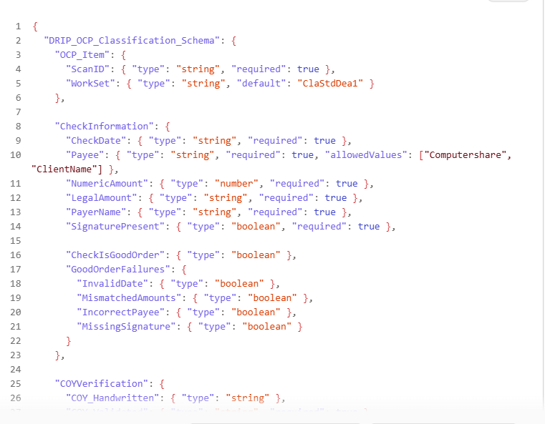
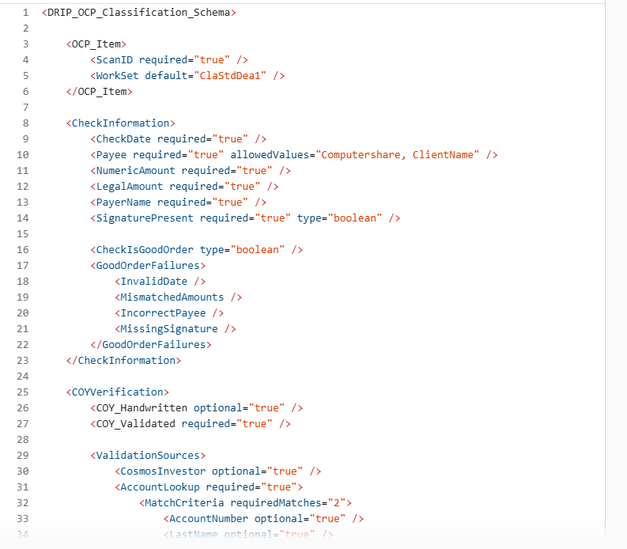
Asking Copilot to design a schema of the details necessary to classify DRIP OCP
What the Schema covers
XML Schema
JSON Schema
1. Validate the check (date, payee, signature, amounts) 2. Verify COY (handwritten COY, validated COY, escalation) 3.Find or create an account (Name, TIN, Scrip setup steps, registration details) 4. Process enrolment forms (W9 rules, TOD logic, direct debit) 5. Apply reinvestment elections 6. Produce final classification output (correct COY + correct account)

Slide 29
Validate that processing DOPs have the same key fields

Slide 30
Step by step flow
SCANNER
TTA
Categorization: Mailroom scans to DRIP OCP
LLM receives category, triggers the appropriate checks to extract information.
Example DRIP OCP:
Extract COY, date, client name, check amount, payer name
Extract account number or last name or registration or alternate ID
Verify 2 details are a match on Cosmos.
Is there an enrolment form? (Y/N)
No match: escalate to human.
OR
Match: 1. Check handwritten COY is correct.
If incorrect, notify Image Centre Cash Team and take the correct COY from Cosmos
Categorization:
Scan of envelope sent to TTA, analyzed according to batch processing rules > categorization determined
If correct, verify if check date is valid, the payee is CPU or client, and amount is valid
invalid data; add comments and escalate to human
Valid data, extract in the right format/schema
Information sent from TTA to Workflow
WKF > BLUEPRISM
Human reviews outputs, triggers right workflow
COSMOS
RPA flows complete transaction

Slide 31
Step-by-step instructions to classify DRIP OCP
Step Name | Original (Non‑Optimized) | AI‑Optimized Version
1. Mandatory Classification | All items scanned to OCP must be classified even if scanned incorrectly. | Always classify the item to OCP. Ignore scanning errors.
2. Verify COY & Account | Match at least 2 criteria (Account #, last name, registration, Alt ID). If unable to locate, escalate. | Verify account using ≥2 identifiers. If no match, attempt Cosmos Investor lookup; if still unresolved, escalate with comments.
3. COY Verification | Image Center writes COY they believe is correct; you must verify COY. | Treat handwritten COY as a suggestion; independently validate COY.
4. Incorrect COY Handling | Email Image Center Cash Team and comment workflow if COY is incorrect. | If COY is wrong: notify Cash Team (Carlos Recinos, Kshatriya Gibson, Nikeya Witcher) and document the action in workflow.
5. Check Good Order – Date | Ensure date is good. | Validate the date is present and valid.
6. Check Payee | Verify check is payable to Computershare or listed client. | Confirm payee = Computershare or correct client (e.g., Intel, AT\&T, IBM).
7. Check Amount Lines | Numeric and legal amounts must match. | Ensure numeric and written amounts match; penmanship not a rejection reason.
8. Signature Match | Check is signed by person listed on the check. | Confirm signature matches payer name.
9. Bad Check Handling | If check is not in good order, comment workflow then classify. | If check fails any validation, log issue in workflow but still classify.
10. Blue Checks | Blue checks may not have COY printed; verify with 2 pieces of info. | For blue checks, perform account verification using ≥2 identifiers (COY often missing).
11. Enrollment Form Detection | Cash request with Initial Enrollment Form → account must be set up in Scrip. | If enrollment form present, proceed to account lookup and potential Scrip account creation.
12. Search for Existing Account | Search by name + TIN to ensure no existing account. | Use Name + TIN to determine whether account exists before creating one.
13. Scrip – Navigate to Add Holder | Select COY → Online Data Entry → SDM → “U” → AH Add Holder. | Select COY → Open Online Data Entry → SDM (Update) → AH Add Holder.
14. TOD Accounts | If TOD requested, set up individual account first and submit form request. | For TOD: create individual account first → generate Beneficiary Maintenance form request.
15. Enter Holder Info | Enter shareholder info using Registration Guide if needed. | Input all required shareholder fields precisely; reference Registration Guide if needed.
16. W9 & Contact Info | Use back of form for phone numbers and W9 certification; do not certify without FATCA verbiage + signature. | Validate W9: certify only if FATCA text present + form signed; extract contact details from back page.
17. Finalize Account in Scrip | Escape twice → search using TIN → copy account info into workflow. | Exit to main screen → search by TIN → store new account info in workflow.
18. Set Reinvestment Election | Based on form: U → PE → transaction number → select plan (SPP1) → F or C. | Code reinvestment: Update → PE → select plan → apply F (Full) or C (Cash). Only if owner signed form.
19. Direct Debit Requests | Insert into DRIP Enrollment using the Direct Debit Authorization form. | If direct debit present, record debit preferences, bank info, and amount into DRIP Enrollment.
20. Final Classification | Classify to correct COY and account after all checks. | After validations and account setup steps, classify to verified COY + account.

Slide 32
Step by step flow
No – not DRIP OCP
Yes – Is the check for any of those categories:
Lost certificate affidavit
Research/subpoena/ESPP fee
Rush/certificate issue fee
Medallion guarantee waiver fee
Transfer fee
No – check for indications like:
“Please invest”
“Optional Cash Purchase”
Dividend reinvestment statement
OCP investment request
A check amount that is not a fixed fee amount (aligns with an investment)
No – not DRIP OCP
Scan the envelope
Does the transaction include a check?
Yes – DRIP OCP but REJECTED
Verify if the check is:
Unsigned
Unacceptable format
Incorrect payee
Missing required info
Yes – DRIP OCP
Yes – DRIP OCP but ACCEPTED (go ahead and extract info)
Yes –not DRIP OCP
LLM call
LLM call
LLM call
If statement

Slide 33
Step by step flow
SCANNER
TTA
Categorization: Mailroom scans to DRIP OCP
LLM receives category, triggers the appropriate checks to extract information.
Example DRIP OCP:
Extract COY, date, client name, check amount, payer name
Extract account number or last name or registration or alternate ID
Verify 2 details are a match on Cosmos.
Is there an enrolment form? (Y/N)
No match: escalate to human.
OR
Match: 1. Check handwritten COY is correct.
If incorrect, notify Image Centre Cash Team and take the correct COY from Cosmos
Categorization:
Scan of envelope sent to TTA, analyzed according to batch processing rules > categorization determined
If correct, verify if check date is valid, the payee is CPU or client, and amount is valid
invalid data; add comments and escalate to human
Valid data, extract in the right format/schema
Information sent from TTA to Workflow
WKF > BLUEPRISM
LLM API call
If-statements
Human reviews outputs, triggers right workflow
RPA flows complete transaction

Slide 34
Address update – DOP vs call center
Extract separately
Then run a test where it should find the overlap

Slide 35
AI tool strategy and approach
Depending on initial test results, the preferred option will be based on a trade-off between LLM accuracy, speed and cost
 | Option 1- multiple specialised agents | Option 2- One agent + RAG | Option 3- Orchestrator agent + specialised agent
Description | Documents classified by human operators, then routed to the specialised AI agent to extract data and sent to workflow for the RPA bot to complete the transaction. | One agent that identifies document intent, and refers to a knowledge base of DOPs to classify and extract data | Intent and categorization handled by the first agent, and then classification and data extraction handled by a second agent (possibly using RAG).
Schematic flow
Automation efficiency | Low | High | Medium
Complexity | Simple (prompt only) | Medium (one or more RAG agents needed) | Medium (one or more RAG agents needed)
OKRs | Accuracy, speed, cost | Accuracy, speed, cost | Accuracy, speed, cost
Transaction
agent
Doc scanned
Doc classified, data extracted
</>
Doc scanned
Transaction
agent
Doc scanned
Classifier
agent
RPA
bot
Orchestrator
agent
Doc categorized
</>
Human
operator
data extracted
</>
Query
Answer
Transaction
processed
Query
Answer
Transaction
agent
Data extracted
Doc classified
Transaction
agent
RPA
bot
RPA
bot
Transaction
processed
Transaction completed
Data
Data
Transaction
agent
Transaction
agent
Multi-classifier Agent

Slide 36
Impact on Mailroom operations journey
Today’s mailroom journey
High volume (known)
Scanner
Mail
Paper
Sorting table > sorted onshore vs offshore based on PO Box
“Offline classification” is conducted here
Offshore/Onshore > priority > specific transaction type
Medallion checks, Check amount ok, verification, stamping and hole-punching certificates
Stamp if copy or certified
Ticket or separator sheet filled out to include all the details that will be entered in Workflow.
Separating paper envelopes that can’t be shredded
Offshore physical table
(classified envelope ready to be scanned)
Batch allocation
Envelope details entered on Workflow
Workflow
Ready for processing (Sean’s world)
White mail
(unknown)
Image scans of envelope
are scanned and verified by human to ensure papers are complete
EDC checks
Onshore physical table
(classified envelope ready to be scanned)
Impact:
Staff can focus on only checking authenticity of documents, stamping and scanning
Automated classification means we abide by time restrictions, regulatory and SLA obligations because we can scan and classify on the same day
Minimizes classification error, which means less envelops will be re-classified/delayed
AI-enhanced mailroom journey (without processing automation)
NO classification, only physical checks conducted
- Medallion checks, Check amount ok, verification, stamping and hole-punching certificates
Stamp if copy or certified
envelopes that can’t be shredded
Mail
Paper
Data verification checks
(EDC or other)
Image scans of envelope
are scanned and verified by human to ensure papers are complete
Tungsten OCR + AI
Envelope intent extracted, classified, relevant data extracted
Workflow
Ready for processing (Sean’s world)
Processing automated via RPA, Scripcomms

Slide 37
Pilot Kick-off & Recap
Pilot objective:
Automate the categorization and classification of incoming documents so that the Account Recordkeeping teams can begin processing transactions the same day.
Transaction type:
Transfers will be the main transaction we will test during the Pilot phase.
Impact:
1. Speed - Same-day transaction processing (compliant with SLAs)
2. Higher accuracy – avoid documents having to be re-classified and minimize delays
Approach:
The pilot will leverage RAG capabilities to enable a Language Model which will allow us to handle a larger variety of combinations compared to training a ML model which is limited to more common types and requires more time to train.

Slide 38


2. Approach for technical design for MVP
Wuestion for TTA, Will image pass through or text only? Does the process wait until LLM response?
1
Phase 1
Phase 2
LLM
Phase 3
Extracts fields for all Proxy variations
Known Form Codes
‘High Volume’
Mail
Yes
SCRIP
Matching logic template
Image (TIF) + Text (JSON)
Proxy?
No
EDC
Paper
E.g., W8, Direct Credit
Documents manually processed from work items in Workflow
Fall-outs
Workflow
Scanner
Hosted in Azure
Manual review
Image (TIF)
Yes
Query (API call)
Unknown
Prompt </>
LLM
Low
OCR (+MSDI)
Image (TIF)
Extracted Text
Model Response
Document Metadata
Phase 3: Call APIs or build bespoke agents to automate transactions
Barcode recognized?
+
Image (TIF)
+
Text (JSON)
Envelope scan
Extracts intent and necessary fields for classification
Confidence?
High
E.g., Share Certificate, Death Cert.
via API
Text (JSON)
No
Metadata created on a page and envelope level
To provide context, there are advantages of a RAG approach over a traditional ML model:
1. Better at handling correspondence containing multiple requests and not singular tasks (majority)
2. No need for data labelling, model training and re-training
3.The LLM can understand the context across the entire set of documents and understand a larger variety of nuance and variation across documents
Stores context as vectors
Vector DB
Converts context to vectors
Embedding model
Context for LLM to classify
1
2
3
4
DOPs
Categories (buckets)
COYs, company names, ticker (API call)
Rules, checks to identify transaction class

Slide 39
Phase 1 with Tungsten is almost complete; we are working automating Phase 2 and 3
Phase 1 – known forms
LLM
Phase 2 - Classification
Phase 3 - Processing
Extracts fields for all Proxy variations
Known Form Codes
‘High Volume’
Mail
Yes
SCRIP
Matching logic template
Image (TIF) + Text (JSON)
Proxy?
No
EDC
Documents manually processed from work items in Workflow
Paper
E.g., W8, Direct Credit
Fall-outs
Workflow
Scanner
Classification
Processing (RPA automation)
Manual review
Image (TIF)
Yes
Where will this be stored?
Doc IMG + extracted details
OCR (+MSDI)
Unknown
LLM
</>
No
RPA automations in BluePrism complete transaction processing, using APIs to SCRIP
Barcode recognized?
Logic to verify data matches with our database
Workflow
Image (TIF)
+
Text (JSON)
Transforms unstructured data into a structured output
Match?
Transcation approved manually for Processing
E.g., Share Certificate, Death Cert.
Extracts intent and fields
No
Yes
XML
Workflow
COSMOS Company
Open question - What load can it handle? We expect to send many requests per day
SCRIP
COSMOS Investor
We will start building RPA automations first, as they represent 75% of potential savings
Elastic in lieu of Cosmos
(dev only, not prod) but easy to set up

Slide 40
What data is necessary to classify?
Query | Data point | Data source (constructed) | What CPU information is used to create this data source?
1. What is the document intent//what does the shareholder want to do? | Categorization bucket (Column A) | Transaction routing table | QRG, Reclassifying and insert scenario document, some information from DOPs
2. For which company? One or multiple? | COY | Company code translation table | Cosmos company
3. Who is the recipient? | Individual | Incoming envelope | Incoming envelope
4. What is the account number? | HIN | Incoming envelope | Incoming envelope
5. Is there an account for the credit? | Yes or no | Incoming envelope | Incoming envelope
6. Run checks to classify | Which company? Is there a doc return form? Section 144 reference? Etc. | Transaction routing table | QRG, Reclassifying and insert scenario document, some information from DOPs
7. Based on results of 6, classify into a specific transaction type | Specific classification type (potentially rationalized) | Transaction routing table | QRG, Reclassifying and insert scenario document, some information from DOPs

Slide 41
Document attributes & structure
Document | Format | Token count
*Ada maximum input per API call 8,192 tokens, and max 2,048 tokens per chunk

Slide 42
Context preparation stages
Extraction
Chunking
Store chunks in database
Embedding model
Emb Database
Search
Results
Docx to text (inc tables)
PDF to text
Tool: OCR (msdi?) or TTA
Approach: Paragraph-based chunks (depending on length of document)
Size: Chunking size determined by the embedding model (~2,048 tokens per chunk for Ada). Azure recommends an overlap of 25%
Tools: Open AI Ada, text-embedding-3-small, text-embedding-3
Chunk metadata:
1.Text
2.Vector
3.Filename (str), page numbers (list), title (str)
Converts text to embeddings
Open AI Ada
Stores embeddings
Input: user query (prompt, which includes extracted text from OCR)
Will retrieve top x relevant results from the database
Response schema – we need to design this based on the input Workflow needs
We also need a way to evaluate
Azure

Slide 43
What is the structure of our tables?
1. Transaction Routing Table
Broad bucket | Specific transaction | Rules/restrictions | DOP rules
Transfer | Transfer - Metlife | xx | xx
2. Company Code translation table
COY (company code) | Company name | Variations | CUSIP | Ticker | Company name change
xx | xx | xx | xx | xx | xx
3. General definitions (word doc)
Definitions of COY, HIN etc. and their numerical structure
Explanation about sender and receiver (two-party transaction)
Categories of sender (individual, 3rd party..)
What fields to extract based on classification category

Slide 44
Automating mailroom and account recordkeeping processes
Automate processing transactions after human verifies classification
Where? EDC?
Scanner
Tungsten
Workflow
RPA automation
WIP
XML
?
?
COSMOS
SCRIP

Slide 45
Phase 1 with Tungsten is almost complete; we are working on automating Phase 2 and 3
Phase 1 – known forms
Phase 2 - Classification
LLM
Phase 3 - Processing
API calls
Extracts fields for all Proxy variations
Known Form Codes
‘High Volume’
Mail
Yes
SCRIP
Matching logic template
Image (TIF) + Text (JSON)
Proxy?
No
EDC
Documents manually processed from work items in Workflow
Paper
E.g., W8, Direct Credit
Fall-outs
Workflow
Scanner
Classification
Processing (RPA automation)
Manual review
Image (TIF)
Yes
Doc IMG + extracted details
OCR (+MSDI)
Unknown
LLM
</>
No
RPA automations in BluePrism complete transaction processing, using APIs to SCRIP
Barcode recognized?
Logic to verify data matches with our database
Workflow
Image (TIF)
+
Text (JSON)
Transforms unstructured data into a structured output
Match?
Transcation approved manually for Processing
E.g., Share Certificate, Death Cert.
Extracts intent and fields
No
Yes
XML
Workflow
COSMOS Company
Open question - What load can it handle? We expect to send many requests per day
SCRIP
COSMOS Investor
Elastic in lieu of Cosmos
(dev only, not prod) but easy to set up

Slide 46
AI tool strategy and approach
1. Leveraging separate agents for each transaction. Once classification has been determined, the documents are presented to an LLM to extract data.
Relevant data extracted
Each agent has own prompt
Relevant data sent for processing
Data verified
Transaction processed
e.g, DRIP OCP agent
Specialised transaction agent
Extracted data sent to workflow
Human validation
RPA bot to complete transaction
Documents classified
Document scanned
(mailroom)
Classification (human)
Classification triggers specialised transaction
agent to extract data
e.g, Sell Stock agent and more…
Specialised transaction agent
Workflow?
2. Using a RAG approach to identify intent and extract data from any incoming set of documents.
Rather than creating separate agents, the LLM is given an instruction to read the documents, identify the intent, and rely on supporting DOPs to extract the data for each case.
Classification and extraction
Relevant data sent for processing
Data verified
Transaction processed
Document scanned
(mailroom)
Agent to identify intent, refer to DOPs to extract necessary data
Extracted data sent to workflow
Human validation
RPA bot to compete transaction
DOPs to identify the specific case and what to extract
3. Leveraging an Orchestrator and then Transaction specialist agent; one to identify the intent and route to the specialized agent for each transaction.
Transaction classified, relevant data extracted.
Each agent has own prompt
Categorization (intent only)
Relevant data sent for processing
Data verified
Transaction processed
Document scanned
(mailroom)
Orchestrator Agent to identify intent, assign queue
Specialised transaction agent
Extracted data sent to workflow
Human validation
RPA bot to complete transaction
e.g, DRIP OCP agent
DOPs to identify the specific case and what to extract
e.g, Sell Stock agent and more…
Specialised transaction agent

Slide 47
AI tool strategy and approach
Depending on initial test results, the preferred option will be based on a trade-off between LLM accuracy, speed and cost
 | Option 1- multiple specialised agents | Option 2- One agent + RAG | Option 3- Orchestrator agent + specialised agent
Description | Documents classified by human operators, then routed to the specialised AI agent to extract data and sent to workflow for the RPA bot to complete the transaction. | One agent that identifies document intent, and refers to a knowledge base of DOPs to classify and extract data | Intent and categorization handled by the first agent, and then classification and data extraction handled by a second agent (possibly using RAG).
Schematic flow
Automation efficiency | Low | High | Medium
Complexity | Simple (prompt only) | Medium (one or more RAG agents needed) | Medium (one or more RAG agents needed)
OKRs | Accuracy, speed, cost | Accuracy, speed, cost | Accuracy, speed, cost
Document scanned and classified
LLM extracts data
RPA completes transaction
Document scanned
Agent classifies, extracts data
RPA completes transaction
Document scanned
Agent identifies intent
Agent classifies, extracts data
RPA completes transaction

Slide 48
Estimated FTE and financial impact (placeholder, WIP)
Tranche | Transaction name | Volume (annual) | Processing FTE (current) | Total FTE (current) | Human AHT | Hours saved | Expected impact (USD)
1 | Drip OCP |  | 0.60 | 1.14
1 | Sell Stock |  | 2.95 | 3.33
 | Transfer |  | 12.64 | 14.40
 | TransferLimited |  | 3.67 | 4.08
 | TransferNonRoutine |  | 3.34 | 3.56
 | TransferSell |  | 3.06 | 3.53
 | BeneficiaryUpdate |  | 2.07 | 2.4
 | CertReplacement |  | 1.64 | 1.97
 | BookTransferReserve |  | 1.48 | 1.64
 | Proxy |  | 1.39 | 1.44
 | CustodialTransfer |  | 1.15 | 1.29
 | ADDRESS |  | 1.11 | 1.38
 | DuplicateHoldingStmt |  | 0.92 | 1.01
 | WireRequest |  | 0.88 | 0.88
 | DueDiligence |  | 0.87 | 1.03
 | MANDATE |  | 0.85 | 1.08
 | CertLost |  | 0.84 | 0.86
 | DealingAdjustment |  | 0.83 | 0.84
 | TransferBeneficiary |  | 0.81 | 0.96
 | EsppTransfer |  | 0.78 | 0.89
 | HoldingConfirmInstit |  | 0.75 | 0.83

